Slide 1

Welcome!!

Slide 2


We are here to assist you
Benefit Counseling
Benefit Applications
Benefit Certification
Academic Advising
College Liaison
Calculator Rental
CAC Readers

Slide 3

Emergency Funding
LCC Foundation Fund
  Limited Funds
  Up to $200.00
  Used for emergency purposes
    Rent, gas, food, utilities, etc.
  Money given, typically repaid later in semester

Slide 4

Veteran appreciation
Veterans Day Memorial Ceremony
Annual Spring breakfast
Veteran Graduation recognition
  Stand to be recognized
  Graduation chord

Slide 5

VET NET ally
Program for LCC staff and faculty
Seminar covers the following areas:
  Vet Net Ally Program mission
  Veteran experience in the classroom
  Military and post-service culture
  “Why I joined”
  “Who would you tell?”
  Veterans issues in higher education
  Being an Ally

Slide 6



OVMA Staff
Andrew Cosgrove
Director
Katie Simpson
Certifying Official
Bill Lapham
Academic Advisor

Slide 7

Questions?
START STRONG!
STAY STRONG!
FINISH STRONG!

Slide 8

STUDENT RESPONSIBILITES

Slide 9

Basics
Know and Understand YOUR benefits
Ask questions to clear confusion
Check your student email
When you need it, SEEK HELP
Maximum Effort

Slide 10
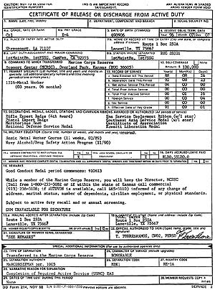
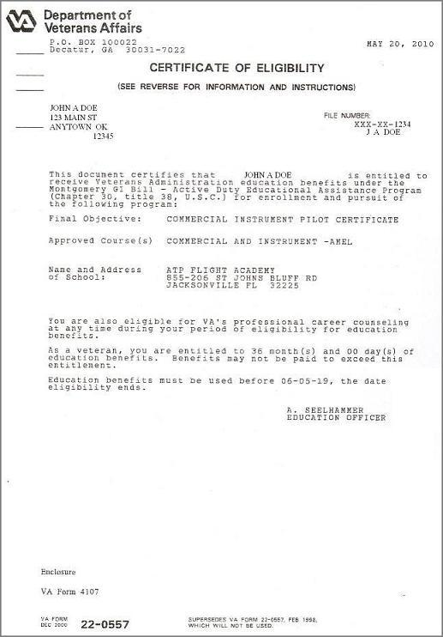
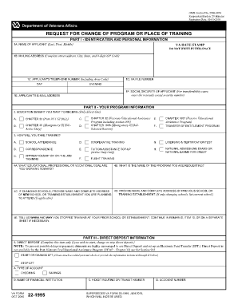
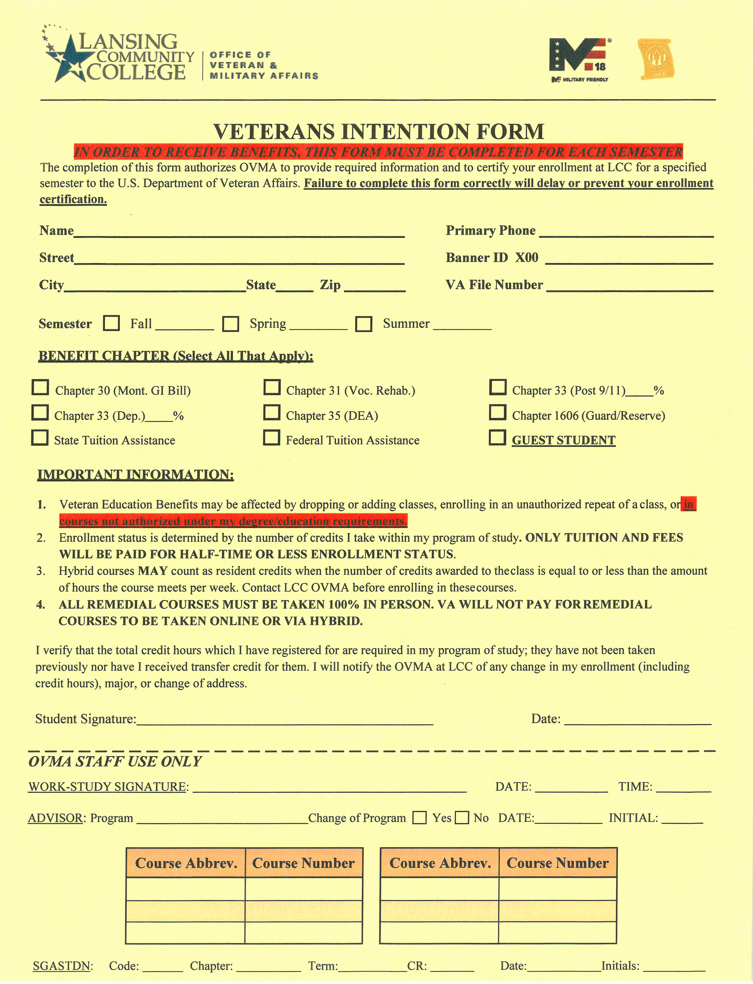
Student Documents
Benefits Intent Form
Statement of Understanding
Release of Information
DD-214 OR VA Letter of Eligibility
All documents completed/submitted online

Slide 11

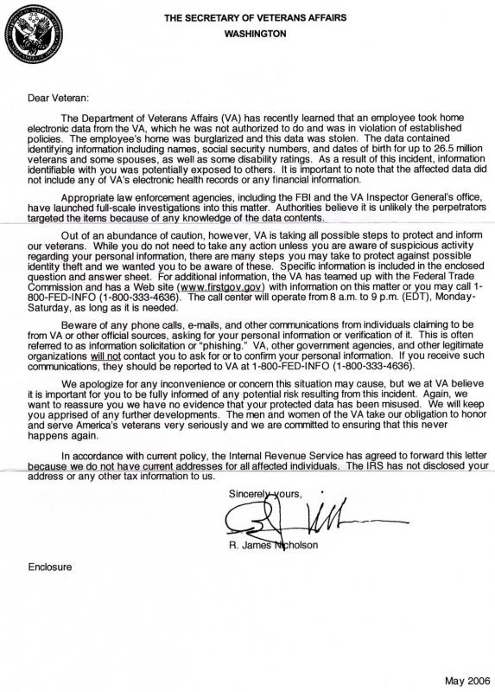
Parent-School Letters
Enrolled at TWO schools…?
You will need a Parent Letter
The letter comes from the school that is granting the degree (The Parent School)
Cannot certify any courses at LCC until the Certifying Official has the Parent Letter

Slide 12

Financial aid
Fill out your FAFSA for each school year!
Do it for the Pell! Up to $6495.00 per academic year of free money!
Go to StarZone for assistance.

Slide 13

Payment plans
Make sure your bill is paid!
Unless you are receiving 100% tuition benefits (CH 31 or Ch 33), you need to set up a payment plan. (Multiple plans offered)
Don’t get dropped! (EACH SEMESTER)
VA/Federal/State funds will be applied to your account as soon as they are received.
  DoD Tuition Assistance tuition amounts will be applied prior to reception of funds

Slide 14

Refunds
Setup your refund preference
Receive refunds for loans, grants, and scholarships awarded to you

Slide 15

VA Debt
Complete the class even if failing!!
  “VA Pays ‘Stupid’, but not ‘Lazy’.”
Talk with us BEFORE you make a schedule change
If you drop, do it during the drop period
WE repay the tuition debt, YOU owe the school
YOU owe housing/book debt

Slide 16
Questions?
START STRONG!
STAY STRONG!
FINISH STRONG!

Slide 17
VA Programs

Slide 18

VA Benefit Chapters
Chapter 30 – Montgomery GI Bill
Chapter 31 – Veteran Readiness/Employment
Chapter 33 – Post 9/11
Chapter 35 – Dependent Educational Assistance
Chapter 1606 – Reserve/Guard

Slide 19

Chapter 30
Standard GI Bill
  Student receives monthly stipend to pay tuition
  Must make payments to school
  Amount received based on Rate of Pursuit
If served 2 years
  Receive up to $1722.00 per month
If served 3 years
  Receive up to $2122.00 per month
Can switch to Post 9/11 any time if eligible
  Cannot go back to 30 once switched
  Receive 12 additional months of Post 9/11 if Ch. 30 is exhausted

Slide 20

Chapter 30 Payment Table
Training Time | Monthly Rate
Full-Time | $2122.00
3/4 Time | $1,592.00
1/2 Time | $1061.00
Less than 1/2 time, more than 1/4 Time | $796.00**
Less than 1/4 Time | $531.00**
**VA will only pay up to the amount of Tuition and Fees
3 Years Active Duty
Training Time | Monthly Rate
Full-Time | $1,722.00
3/4 Time | $1,292.00
1/2 Time | $861.00
Less than 1/2 time, more than 1/4 Time | $796.00**
Less than 1/4 Time | $431.00**
**VA will only pay up to the amount of Tuition and Fees
2 Years Active Duty

Slide 21

Chapter 31 (VR&E)
VA disability rating of 20% or higher
  Set up appointment with VA Counselor
  Counselor approves benefit
  Counselor approves program/courses
Can switch from Post 9/11
  Switch to VRE before Post 9/11 is exhausted
  Can elect to keep Post 9/11 MHA
  Will receive additional 12 months of benefits
Use VR&E first
  Won’t count towards Post 9/11 time
  Receive VR&E monthly housing rate
  Receive up to 84 months of total benefits

Slide 22

Chapter 31 (VR&E) Payments
Tuition/Fees
  Paid directly to school
Books/Supplies
  Up to $1000/year (Post 9/11 rate)
  Up to $600/year (VR&E rate)
Monthly Housing
  Up to $1446/month (Post 9/11 rate)
  $605 - $1079/month (VR&E rate)
    Number of dependents
Additional Needs
  Computers, software, etc.

Slide 23

Chapter 33 (Post 9/11)
Up to 36 months of benefits
15 years after discharge date to use
  No deadline if discharged AFTER 1/1/13
Percentage paid based on active duty time
  See Payment Table slide
  Includes tuition/fees and MHA payments

Slide 24

Chapter 33 Payments
Must verify attendance each month
Tuition/Fees
  Paid directly to school
Books/Supplies
  Up to $1000/year
    Up to $500/semester
Monthly Housing (MHA)
  Up to $1446/month
  Must attend at least one class in person
  Must attend MORE THAN ½ time
    MHA paid 1st of each month

Slide 25
Chapter 33 Payment Table
Training Time | Monthly Rate
Full-Time | $1446.00
3/4 Time | $1,157.00
MORE THAN 1/2 Time | $868.00
LESS THAN 1/2 time | $0.00**
**Must be over half time to receive MHA funds
Discharge AFTER 1/1/2018
Training Time | Monthly Rate
Full-Time | $1,541.00
3/4 Time | $1,233.00
MORE THAN 1/2 Time | $925.00
LESS THAN 1/2 time | $0.00**
**VA will only pay up to the amount of Tuition and Fees
Discharge PRIOR TO 1/1/2018

Slide 26
Chapter 33 Percentage Table
Service Requirement: Active Duty Time (Not including BCT or IAT) | % of Maximum Benefit Payable
36+ months | 100
Purple Heart Recipient (Regardless of time) | 100
30 continuous days with disability discharge | 100
At least 30 months; less than 36 months | 90
At least 24 months; less than 30 months | 80
At least 18 months; less than 24 months | 70
At least 06 months; less than 18 months | 60
At least 90 days; less than 06 months | 50

Slide 27

Chapter 35 (DEA)
Student receives monthly stipend to pay tuition
  Must make payments to school
    Setup payment plan with college
    Once balance paid, keep the rest
  Receive up to $1248.00 per month
    See Payment Table
No additional stipend
No book allowance

Slide 28
Chapter 35 payments
Chapter 35 Payment Table
Training Time | Monthly Rate
Full-Time | $1,298.00
3/4 Time | $1026.00
1/2 Time | $753.00
Less than 1/2 time, more than 1/4 Time | $753.00**
Less than 1/4 Time | $325.00**
**VA will only pay up to the amount of Tuition and Fees

Slide 29

Chapter 1606
National Guard and Reserve
  No active duty time
No tuition and fees
No book stipend
Receive monthly stipend
  Based on Rate of Pursuit (See Payment Table)
  Possible “Kicker” (Extra Money)
    (Check enlistment contract and/or College Fund Contract)
  Must verify attendance
    Last day of each month (Cannot verify prior to last day)
    Payment received approx. 1 week after

Slide 30
Chapter 1606 payments
Chapter 1606 Payment Table
Training Time | Monthly Rate
Full-Time | $407.00
3/4 Time | $305.00
1/2 Time | $204.00
Less than 1/2 time, more than 1/4 Time | $204.00
¼ Time or Less | $102.00
**Rates could be higher if GI Bill Kicker is applicable

Slide 31

MING Tuition assistance
Tuition assistance for MI National Guard service members
  Must remain in good standing with MI Guard
Reimbursement directly to student AFTER semester
  Student submits grades and costs
Pays up to $14,400 Tuition and Fees per academic year
Must complete application by 2 weeks AFTER semester starts
Must use Federal Tuition Assistance first
Benefit can be used in conjunction with other benefits
Must pass all classes with 2.0 or higher for reimbursement

Slide 32

Federal Tuition assistance
Tuition assistance for Army National Guard/Reserve
Up to $4000/year or 16 credit hours
Apply through Army IgnitED website
  Create account using CAC
Courses invoiced by LCC Veteran Services
  Student must submit Education Path
  Student must request FTA by 1 day prior to course start
  Everything done on Army IgnitED site
Benefit can be used in conjunction with Chapter 1606

Slide 33

Mi children of vets grant
Children of MIA, deceased or completely disabled veterans
  Used in conjunction with Chapter 35 GI Bill
  Veteran must have lived in Michigan
  Stepchildren not eligible
  Must file FAFSA
Provides tuition assistance for 16-26 year olds
  Michigan resident for at least 12 months
Four years of assistance
Must enroll at least half time
  Receive up to $11,200.00 total
    Up to $2,800.00 per academic year (Full Time)
    Must maintain 2.25 overall GPA
    No student loan default

Slide 34

Mi Veteran Trust Fund
Provides emergency grants to eligible vets and dependents
  Must be MI resident
  Honorably Discharged
  180 days of Active Duty Service
    Less than 180 days with service disability
Contact MI Veteran Affairs Agency
  800-MICH-VET

Slide 35
Questions?
START STRONG!
STAY STRONG!
FINISH STRONG!

Slide 36
Certifying Official

Slide 37
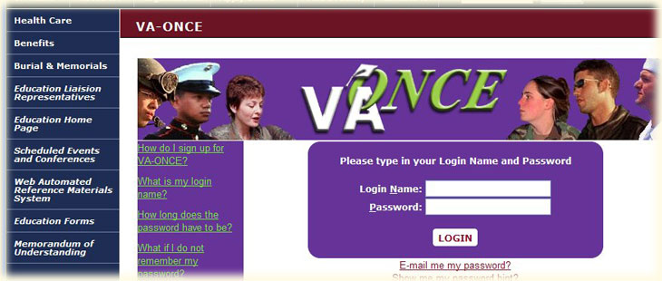
Function
Submit class enrollment schedules to the Department of Veteran Affairs
Adjust enrollment certifications when schedule changes are made
Help address VA Education Benefit related issues/concerns
Guide students’ usage of GI Bill so they get the most out of the benefits

Slide 38
VA Policies

Slide 39

Approved Programs
Programs of study must be approved by VA
Cannot enroll in unapproved programs
Approved programs updated each academic year
Ask if program approved

Slide 40

85/15 Rule
Programs cannot contain more than 85% VA students
Percentages reported each semester
Cannot enroll in program consisting of more than 85% VA population
Likelihood is low (Total VA percentage: 2%)
Ask before a change is made

Slide 41

Two-Step Process
Certification policy to mitigate VA debt
Certify credit amounts
Certify tuition amounts after the drop period

Slide 42

Housing Allowance
Monthly Housing Allowance (MHA) provided to Chapter 33 and Chapter 31 students
Must attend half time to receive MHA
Must attend ONE in person course to receive full MHA payment

Slide 43
Enrollment Status
Fall and Spring
Training Time | Credit Amount
Full-Time | 12
3/4 Time | 9 - 11
1/2 Time | 6 - 8
VA will not pay BAH for less than 1/2 Time
Summer (8 Week Term)
Training Time | Credit Amount
Full-Time | 6
3/4 Time | 4 - 5
1/2 Time | 3
VA will not pay BAH for less than 1/2 Time

Slide 44

Hybrid Courses
Online/In Person courses
Hybrid courses are considered in seat courses

Slide 45

Remedial College Courses
Courses designed to bring a student to “college level” in core subjects (Math, Reading, Writing)
Enrollment based on college placement test scores.
VA will pay for these courses
Must be taken in person, not completely online
  Hybrid remedial courses can be certified to the VA

Slide 46
Questions?
START STRONG!
STAY STRONG!
FINISH STRONG!

Slide 47
Academic Advising

Slide 48
10 advising tips
Only register for courses that are listed in your curriculum guide or in Degree Works. The VA won’t pay for anything else. We check. MyLCC > Banner > Student > Degree Works.
Degree Works lists your program. To change programs: MyLCC > Profile > Change Program
You need at least 60 credit hours to get an associate’s degree; at least 15 of them have to be taken here to get a degree. That’s credit for 15-20 classes total.
MSU requires 28 credit hours to transfer. They won’t take more than 60. They want ENGL121, ENGL122, HIST211 or 212, MATH120. Keep your GPA above 3.3. Apply in November of the year before you want to start in the Fall. MSU advisors in Gannon Advising.

Slide 49
10 advising tips
If you have gone to college before, transfer your transcripts here electronically. Sending unofficial transcripts to get placement levels was NOT “transferring your transcripts.” If you didn’t insert a credit card number, you didn’t transfer your official transcripts. Don’t forget about Joint Service Transcripts!
There are two kinds of associate’s degrees, transfer and job. The first requires the MTA (Michigan Transfer Agreement), the second, CORE. Both are General Education reqs.
The MTA is COMP 1, COMP 2 or COMM, 2 Humanities, Math, 2 Natural Sciences, and 2 Social Sciences, all from different disciplines. Add the requirements of your discipline and go. Takes a year (F, Sp, Su), full-time.

Slide 50
10 advising tips
CORE is COMM, Global Perspectives and Diversity, Math, Natural Science, and Writing, one course each. Add the requirements of your discipline and get a J-O-B. West Campus/Air.
All curricula expire in 5 years no matter when you start. If you take longer than that, expect to change programs, even to stay in the one you’re working on. Required courses may change.
Know registration dates for EACH semester! Register early!

Slide 51
Questions?
START STRONG!
STAY STRONG!
FINISH STRONG!

Slide 52
Other Services

Slide 53
Center for student access
Andy George
Access Consultant
Contact: 517-267-5690
georga14@star.lcc.edu

Slide 54
Adult Resource Center
Ashlee Stokes
Adult Resource Center Coordinator
Contact: 517-483-1213
stokea@star.lcc.edu

Slide 55
Success Coaching
Duane Portee
Military-Connected Student Success Coach
Contact: 517-483-1470
porteed2@star.lcc.edu

Slide 56
Counseling Services
Pam Davis
Licensed Professional Counselor
Contact: 517-483-1924
davisp@star.lcc.edu

Slide 57
Reminders

Slide 58
Please Remember
Fill out Intent Form each semester and do it early!
Notify us if you add or drop a course
Meet with the Advisor when you need to!
Submit JSTs and other transcripts. (Ask for re-evals when needed)
Fill out FAFSA (Pell Grant)
CHECK YOUR STUDENT EMAIL FOR INFORMATION AND UPDATES!!!!

Slide 59
Questions?
START STRONG!
STAY STRONG!
FINISH STRONG!

