Slide 1


How to Do Business with
Lansing Community College
Purchasing 101

Slide 2
Discussion Question #1
Have you done business with Lansing Community College in the past?
  Yes
    In what capacity?
  No
  Unsure
    Explain

Slide 3
Discussion Question #2
How would you categorize your offered product and/or services?
  Construction
  Educational
  Information Technology
  Office or Administrative Supplies
  Other
    Explain

Slide 4
Who are we?
Lansing Community College’s Purchasing Department is the centralized procurement office for the College.
As a central resource, the Purchasing Department serves the community by developing purchasing policies and procedures; providing tools to enable the best value purchase of goods and services; and assures that College purchases comply with applicable state, federal and local laws as well as industry standards and best practices.

Slide 5
What do we purchase?
Furniture • Electrical Supplies • Cleaning Materials • Computers • Equipment • Vehicles • Uniforms • Advertising • Promotional Products Books • Office Supplies • Auto Parts • Auditing Services • Software • Hardware • Maintenance • Janitorial Services• Lighting • Consulting Services • Advertising • Apparel • Fire Alarm Services • Grounds Maintenance • Snow Removal • Building Materials • Hand Tools • Phones

Slide 6
What begins the Purchasing Process?
A need for a commodity or service is developed;
Proper internal approvals are received;
The proper requisition and supporting information is submitted to the Purchasing Department;
If the request is more than $5,000, the LCC Purchasing Department will conduct the proper public solicitation process;
Purchases greater than or equal to $100,000 are subject to Board of Trustees approval.

Slide 7
Public bidding process
LCC’s public solicitations are posted on BidnetDirect.com.
Interested contractors must register with the site in order to respond to solicitations posted by the College.
The platform has both a free and paid membership option.
BidnetDirect.com Questions regarding the registration process should be directed to support@bidnet.com or 1-800-835-4603.

Slide 8




Public bidding Process continued
Project Planning
Drafting the Public Solicitation
Issuing the Public Solicitation
Reviewing Proposals and Awarding Contract

Slide 9
Registration Guidelines MITN
Go to the following website: www.bidnetdirect.com/mitn.
Click the Vendor Registration button to get started.
Complete the Registration page. You can subscribe to just LCC for free, or a wider selection of agencies for a fee.
For questions regarding registering on the system, please call 1-800-835-4603 and select the vendor support option.

Slide 10
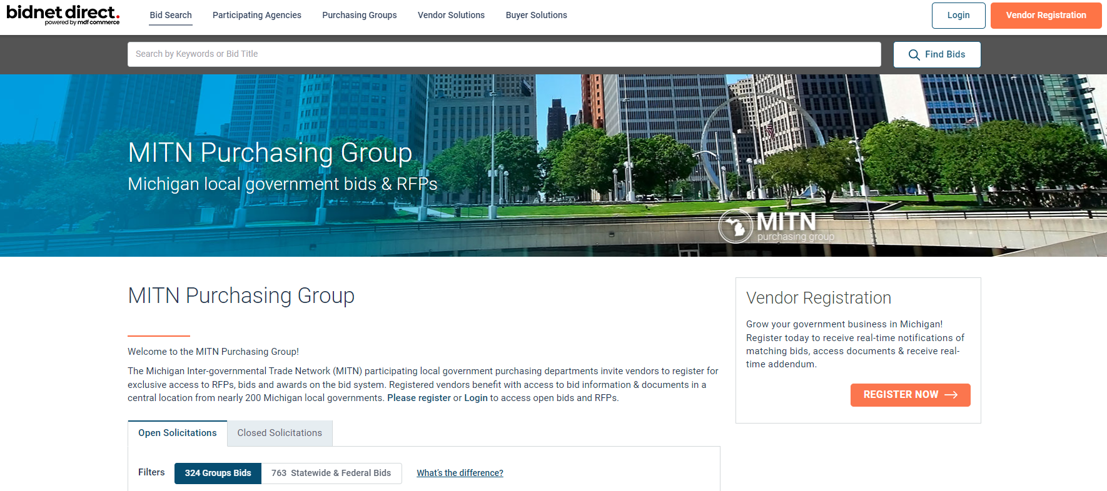
Registering with MITN

Slide 11
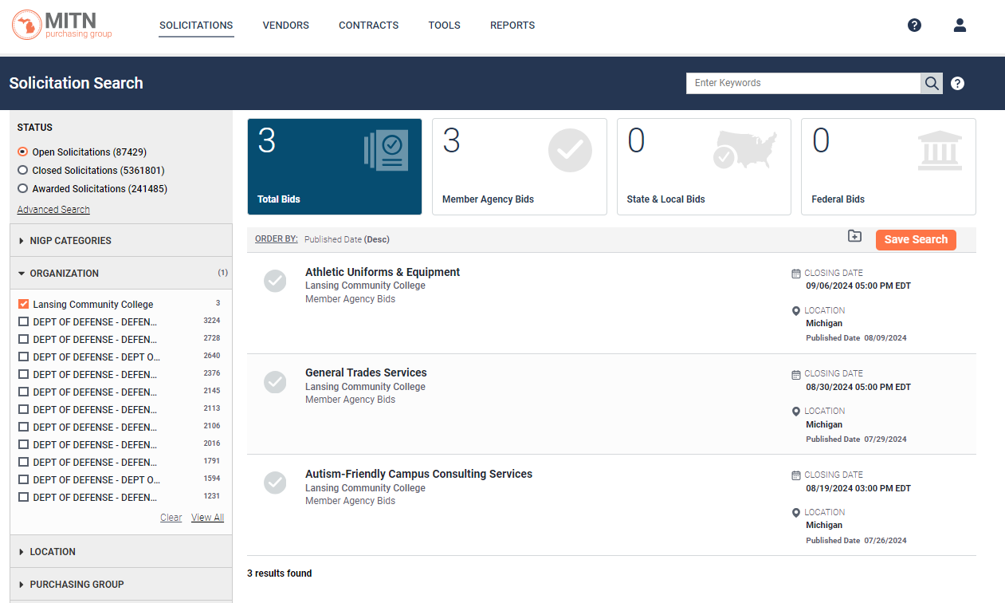
Post Registration with mitn

Slide 12
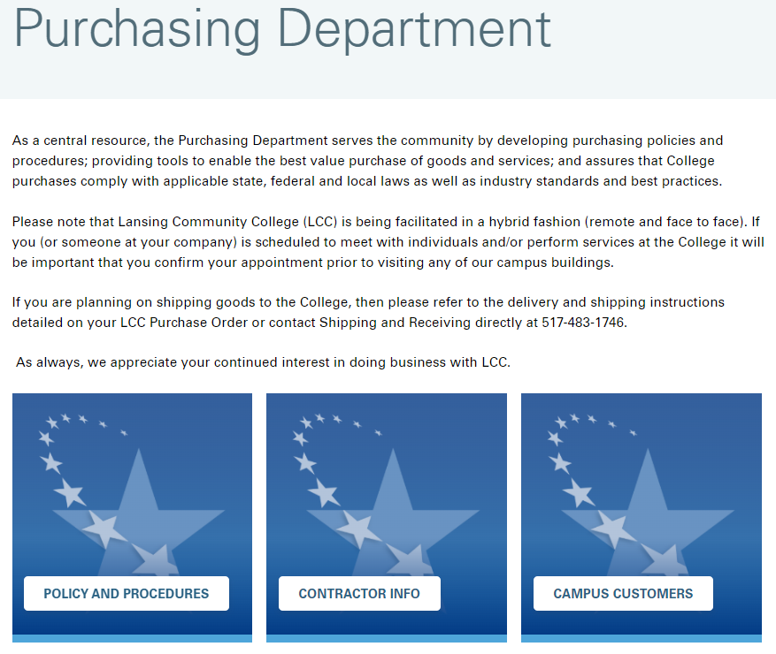
Additional Resource –
Purchasing Webpage: lcc.edu/purchasing

Slide 13

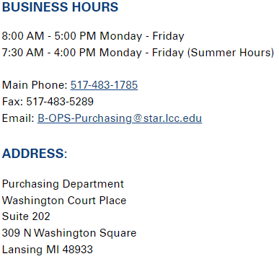
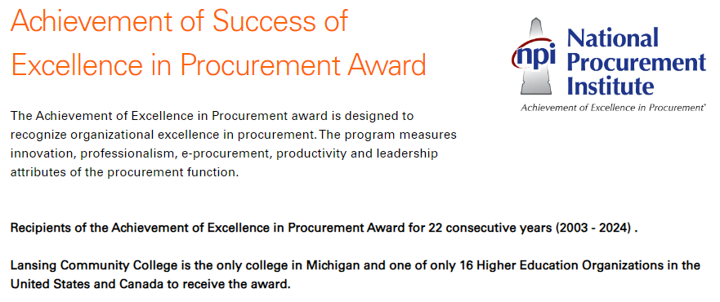
Thank You

