Slide 1
Organizational Change Process
Human Resources, July 2026

Slide 2

Purpose & Scope
Purpose - Define the steps for implementing an organizational structure.
Scope – Applies to all divisions who are seeking to make organizational changes to their divisional or department structure.

Slide 3
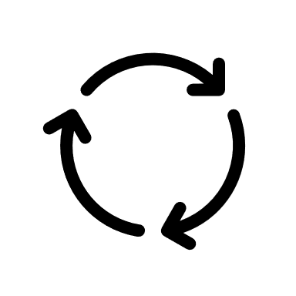

Who’s Responsible??
Division/Department Administrator - Responsible for creating the conceptual plan detailing an overview of proposed organizational changes.
Human Resources - Responsible for coordinating the process and assisting with the implementation with all relevant stakeholders.

Slide 4

When To Use The Process
The organizational change process should be followed for changes ranging from department name changes to full reorganization of a department/division.
Depending on the change, the full process does not need to be followed. Reach out to HR to determine which steps apply.

Slide 5
The Process!
STEP 1
Conceptual Plan:
  Administrator prepares and submits conceptual plan to that provides an overview of the designed organizational changes (rationale, impact on other areas, financial impact, & timeline) to ELT member.
STEP 2
Submit Detailed Plan to HR:
  Include conceptual plan, old & new org charts, impact on employees, updated job descriptions, budget analysis, and timeline.
STEP 3
HR Review & Approval:
  HR will review the following: classification changes for new & current job descriptions, impact on current staff, collective bargaining unit obligations, timeline, and modify documents as needed.
STEP 4
Vacancy Management Review Team (VMRT) Approval:
  VMRT will review the finalized plan and issue approval or other recommendations.
Implementation:
  HR will work with the administrator to finalize job descriptions & org charts, work with OBFA, HR system updates, campus directory, Marketing, Labor Relations, announcements, etc.
STEP 5

Slide 6
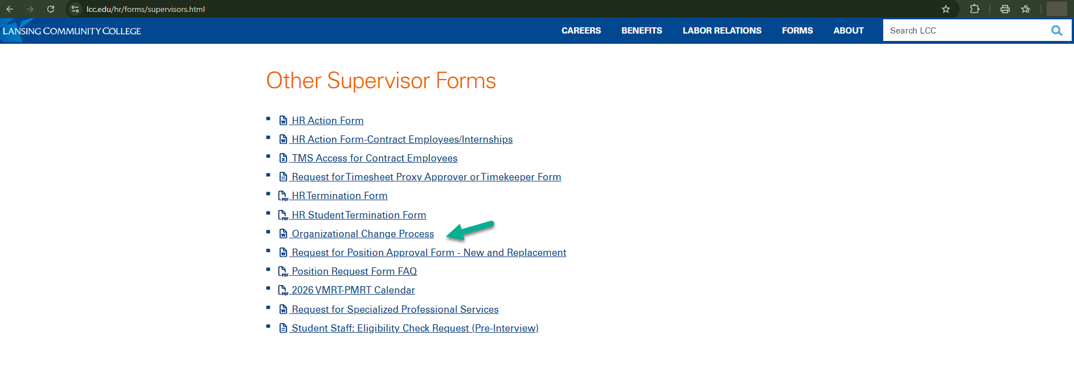
The Organizational Change Process is located here:
  HR Website - https://www.lcc.edu/hr/forms/administrative.html

Slide 7


Questions?

