Slide 1
How to Do Business with Lansing Community College

Slide 2
Poll Question #1
Have you done business with Lansing Community College in the past?
Yes
No
Unsure

Slide 3
Poll Questions #2
How would you categorize your offered product and/or services?
Construction
Educational
Information Technology
Office or Administrative Supplies
Other

Slide 4
Who are we and what do we purchase? Central Procurement Office for the College
Furniture • Electrical Supplies • Cleaning Materials • Computers • Equipment • Vehicles • Uniforms • Advertising • Promotional Products Books • Office Supplies • Auto Parts • Auditing Services • Software • Hardware • Maintenance • Janitorial Services• Lighting • Consulting Services • Advertising • Apparel • Fire Alarm Services • Grounds Maintenance • Snow Removal • Building Materials • Hand Tools • Phones

Slide 5
What begins the Purchasing Process?
A need for a commodity or service is developed;
Proper internal approvals are received;
A requisition is submitted to the Purchasing Department;
If the request is below $4,999 a purchase order is created;
If the request is in excess of $4,999 a solicitation process will begin;
Purchases greater than or equal to $100,000 are subject to Board of Trustees Approval.

Slide 6
Non-Competitive Purchases (<$5,000)
Purchasing Card Transactions
Memberships
Sponsorships
Event Registrations
Professional Development
Performing Arts Scripts
Performing Arts Props
Rental Cars
Venue Rental
Misc. Goods
Misc. Services
Emergency Purchases
Note: Very few purchases fall into this category. Interested Contractors/Vendors can submit product brochures and request meetings through the Purchasing Department at B-Ops-Purchasing@star. lcc.edu.

Slide 7
Competitive Purchases (>=$5,000)
Competitive Solicitations are posted at www.demandstar.com or www.bidnetdirect.com
RFQ: Request for Quotation (Common Commodities/ One-Time Purchase)
ITB: Invitation to Bid (Common Commodities/ One-Time Large Dollar Purchase or Longer Term Purchase)
RFP: Request for Proposal (Specialized Product/ One-Time Purchase or Longer Term Purchase)
RFI: Request for Information (Posted when input is needed from the vendor community prior to posting ITB or RFP)
Interested Contractors/Vendors must register with the site in order to view and respond to solicitations.
Note: Most purchases fall into this category

Slide 8
Public Bidding Process
LCC solicitations are posted on either BidNetdirect.com or DemandStar.com. Interested contractors must register with these sites in order to respond to solicitations posted by the College. Both platforms have both free and paid membership options.
BidNetdirect.com Questions regarding the registration process should be directed to support@bidnet.com or 1-800-835-4603.
DemandStar.com Questions regarding the registration process should be directed to hello@demandstar.com or 1-866-273-1863.

Slide 9
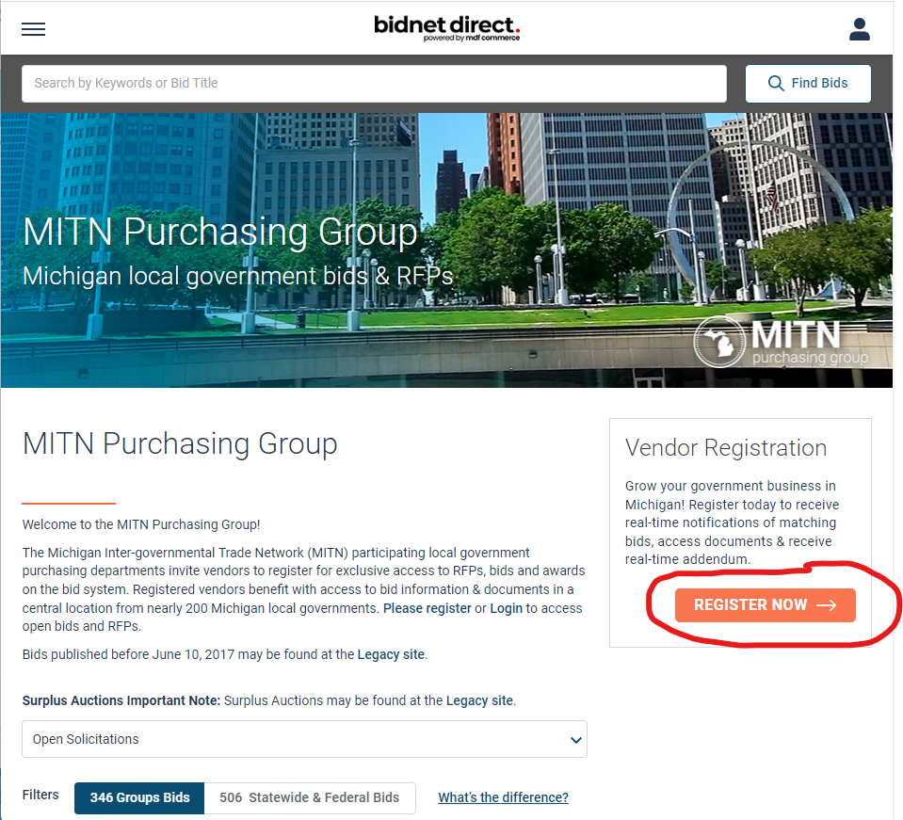
Registering with MITN

Slide 10
Registration Guidelines MITN
Go to the following website: www.bidnetdirect.com/mitn.
Once the page loads, on the bottom right-hand side there is a “Register Now” button in orange – Choose this button.
Complete the Registration Page. You can subscribe to just LCC for free, or a wider selection of agencies for a fee.
If any vendors have questions regarding registering on the system, please call 800-835-4603 and hit option 2 for vendor support (Monday through Friday, 8:00 A.M. - 8:00 P.M. Eastern Time).

Slide 11
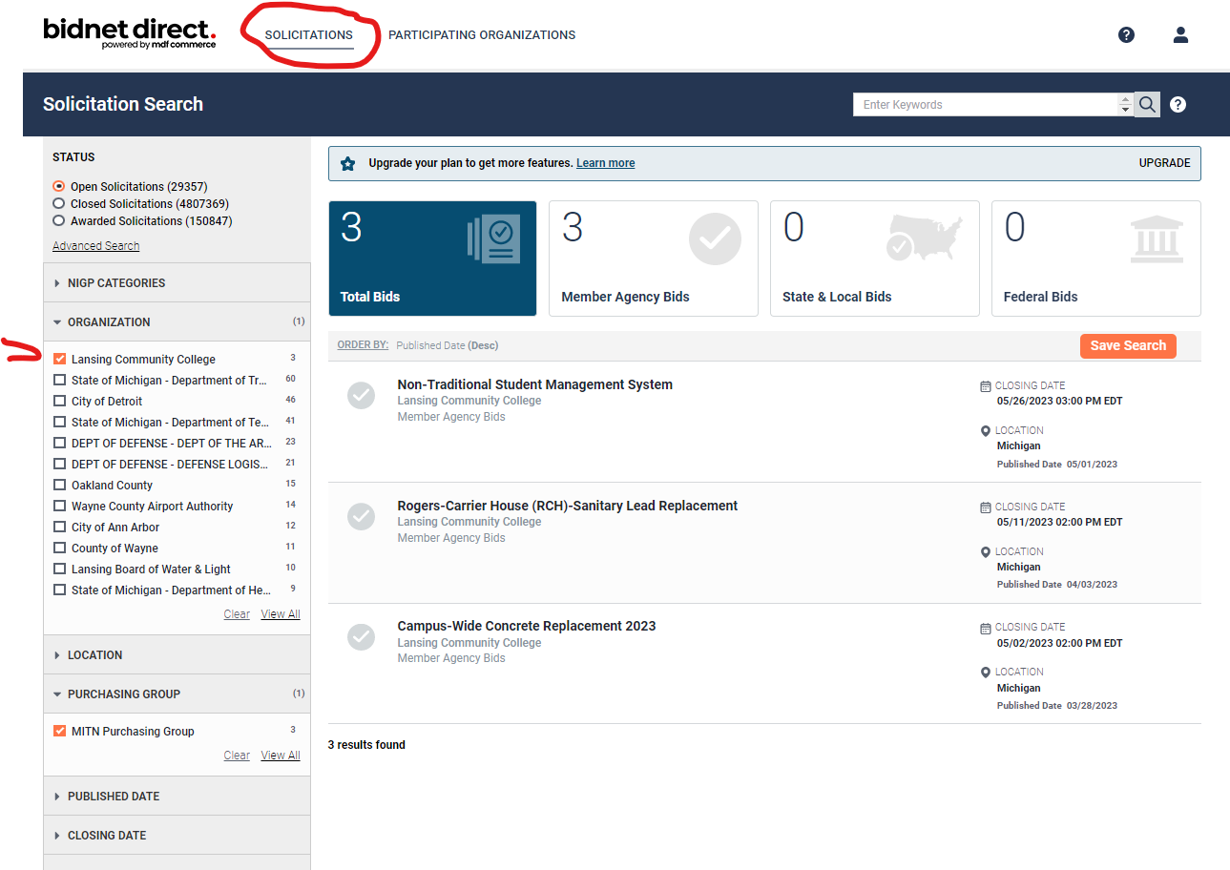
Post Registration

Slide 12
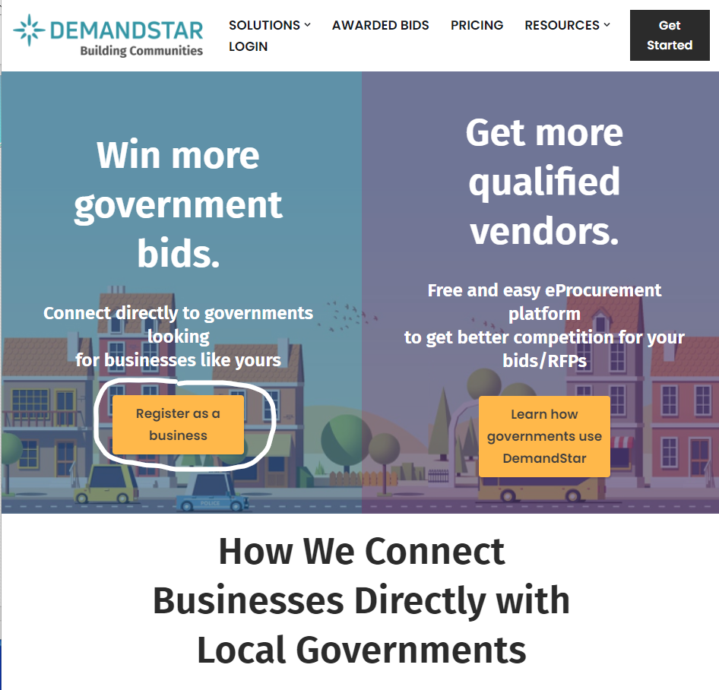
Registering with DemandStar

Slide 13
Registration Guidelines DemandStar
Go to the following website: network.demandstar.com/.
Once the page loads, on the left-side there is a “Register as a Business” button in orange – Choose this button.
Complete the Registration Page. You can subscribe to just LCC for free, or a wider selection of agencies for a fee.
If any vendors have questions regarding registering on the system, please call 866-273-1863 for vendor support (Monday through Friday, 8:00 A.M. - 8:00 P.M. Eastern Time) or email support@demandstar.com.

Slide 14
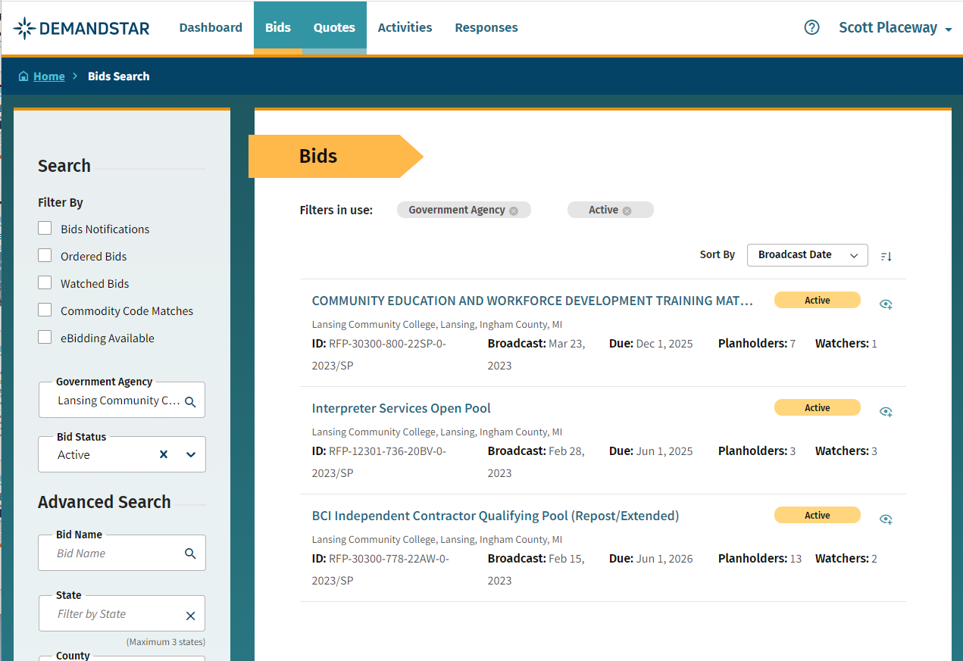
Post Registration

Slide 15
Additional Resource – Purchasing Webpage: lcc.edu/purchasing

Slide 16
Thank You
Contact Us
Purchasing Department Washington Court Place, Suite 202 309 N Washington Square
Main Phone: 517-483-1785 Fax: 517-483-5289 Email: B-OPS-Purchasing@star.lcc.edu

