Slide 1
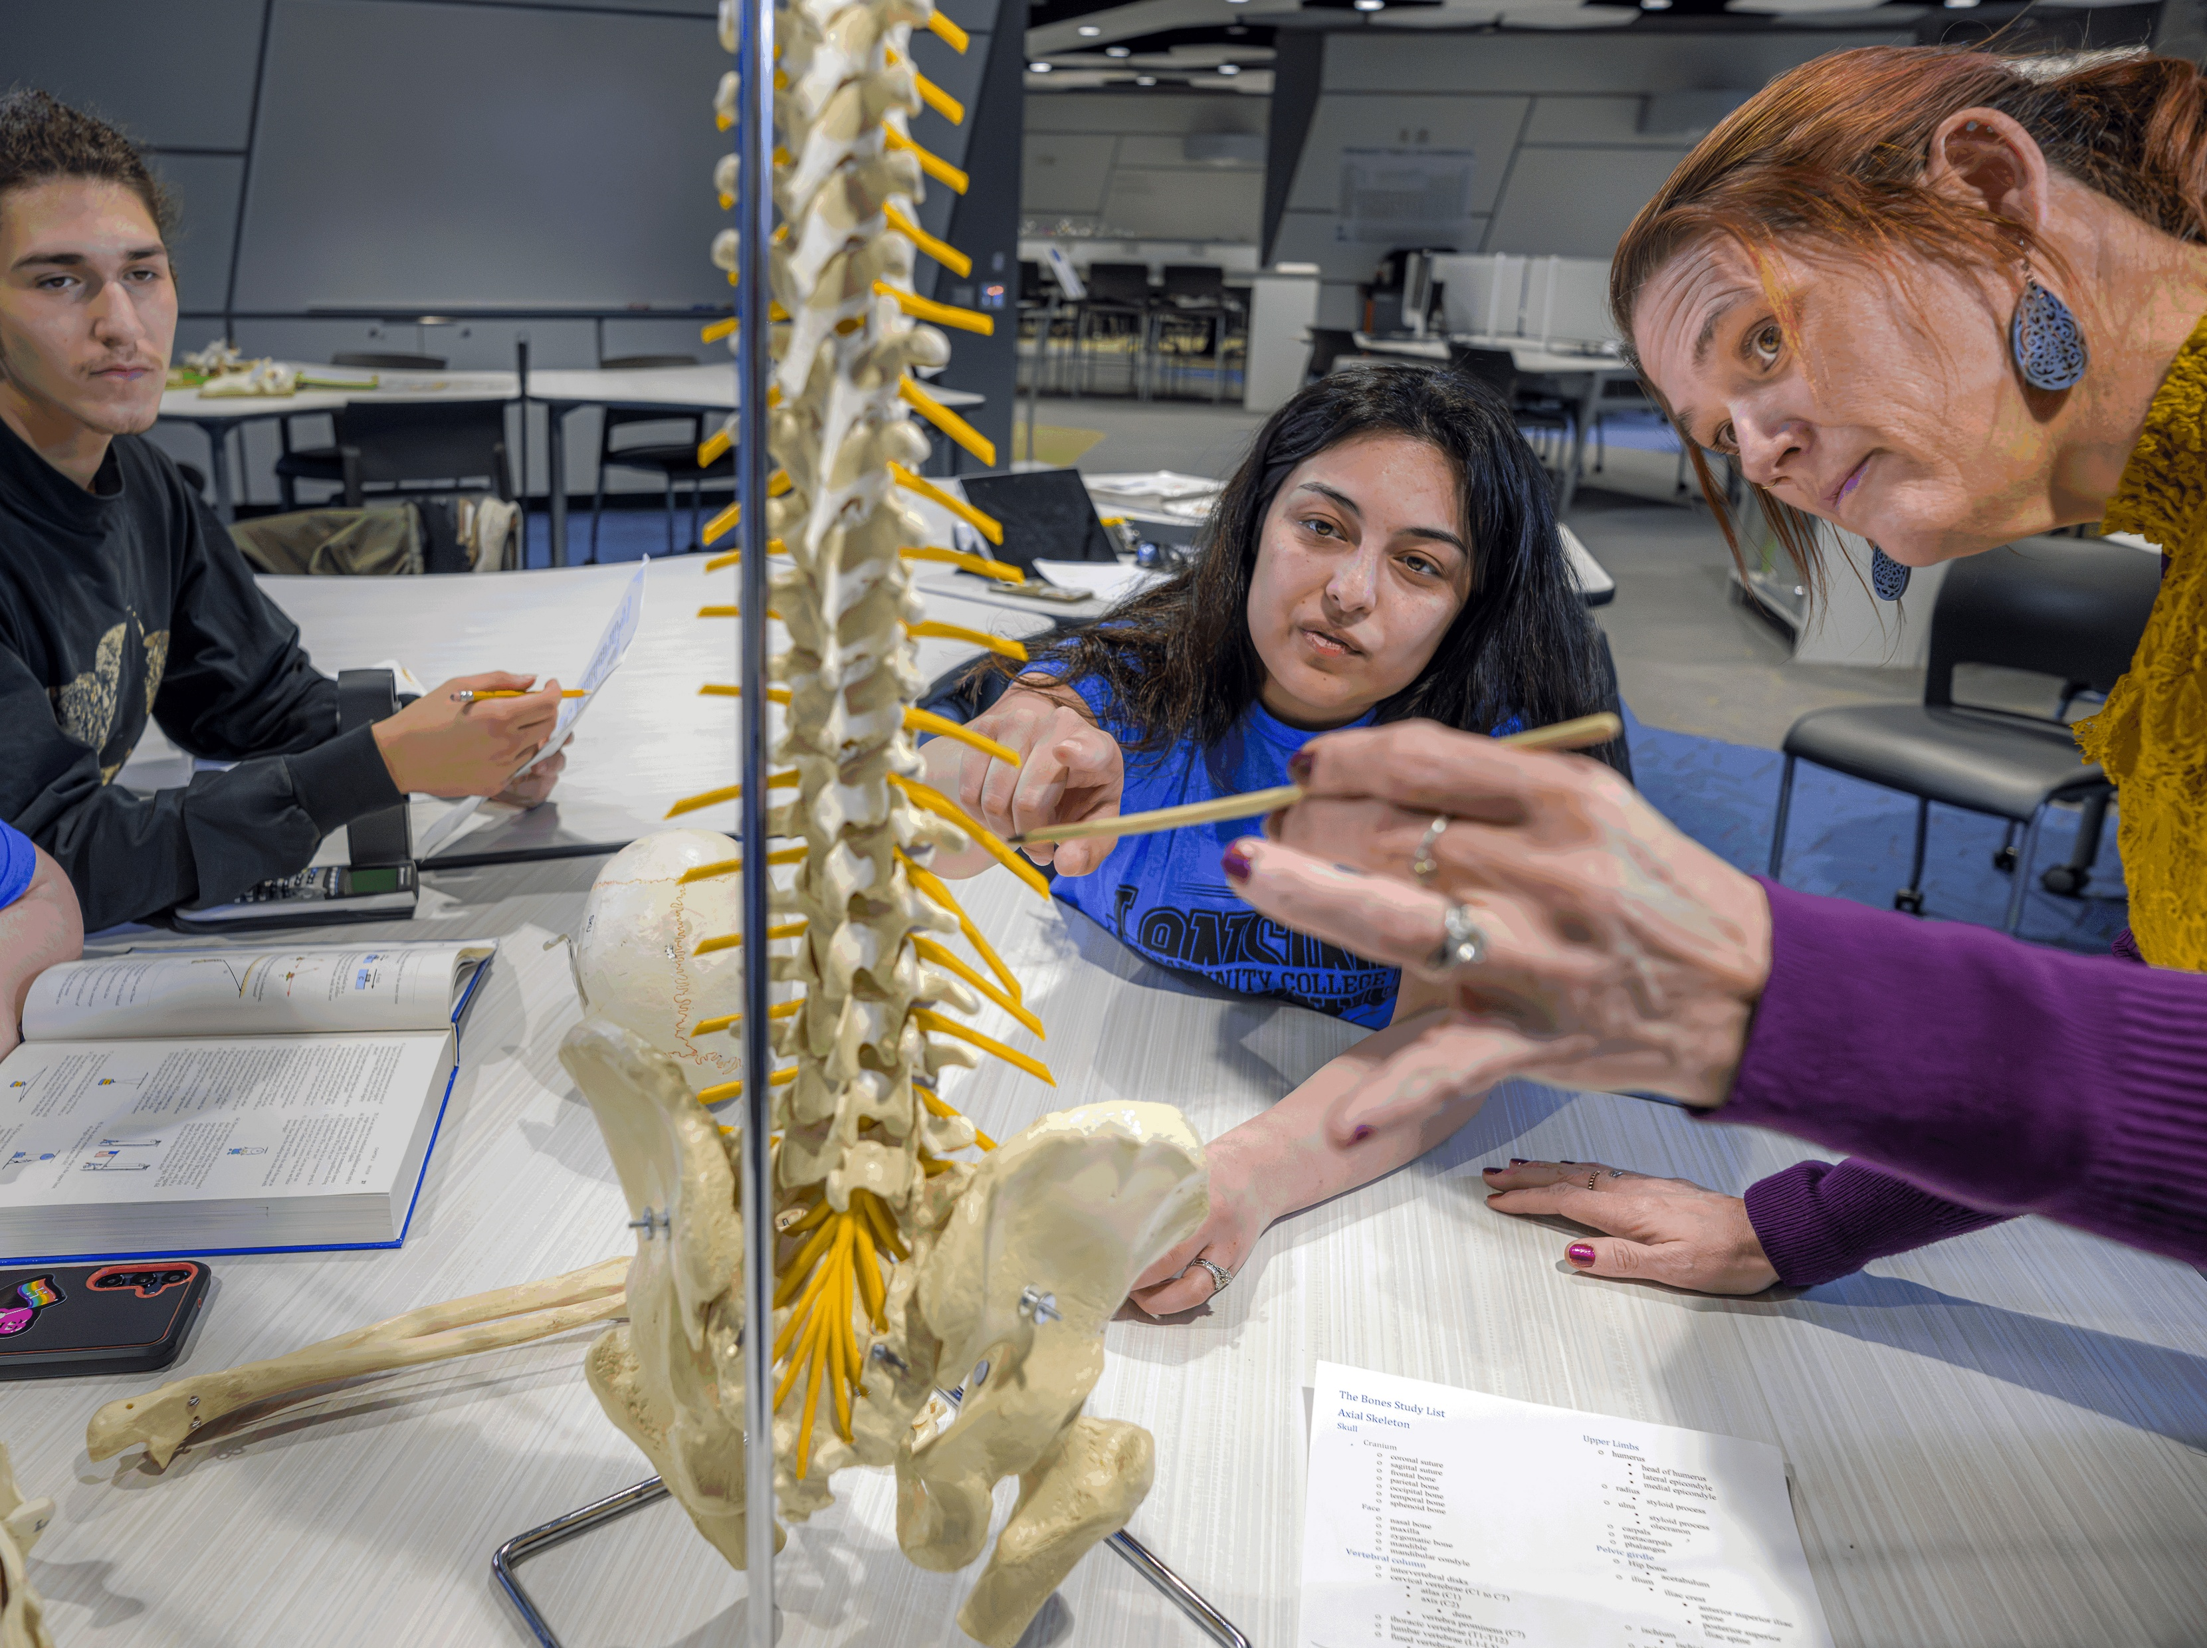
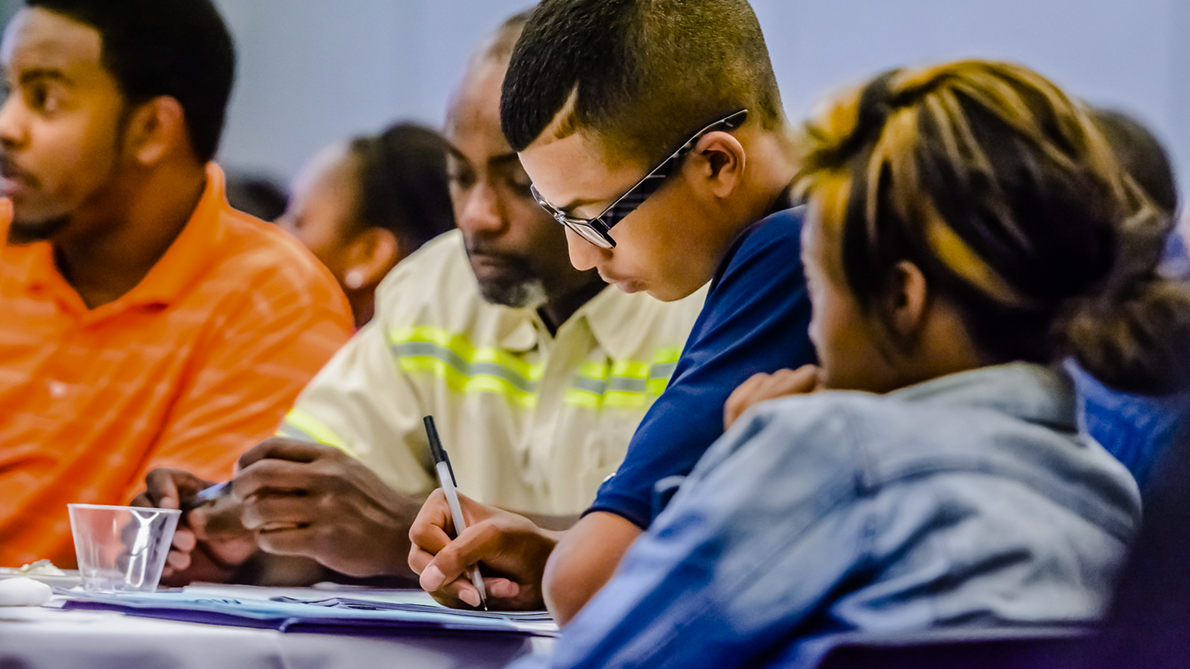




Notes:
Let's start with a belief.
We believe that every student who walks through our doors, regardless of how their brain works, regardless of how they learn, regardless of how they communicate, deserves not just access to education, but the genuine opportunity to thrive.
We believe that “different” isn't less.
We believe that when a determined student can't succeed at LCC, the barrier isn't the student. The barrier is the environment.
That's what we're here to talk about today. Not a project. Not an initiative. But living out what we say we believe, serving our diverse community with integrity, creating a supportive environment that's truly relevant to every learner, and delivering on our commitment to transformative education.

Slide 2
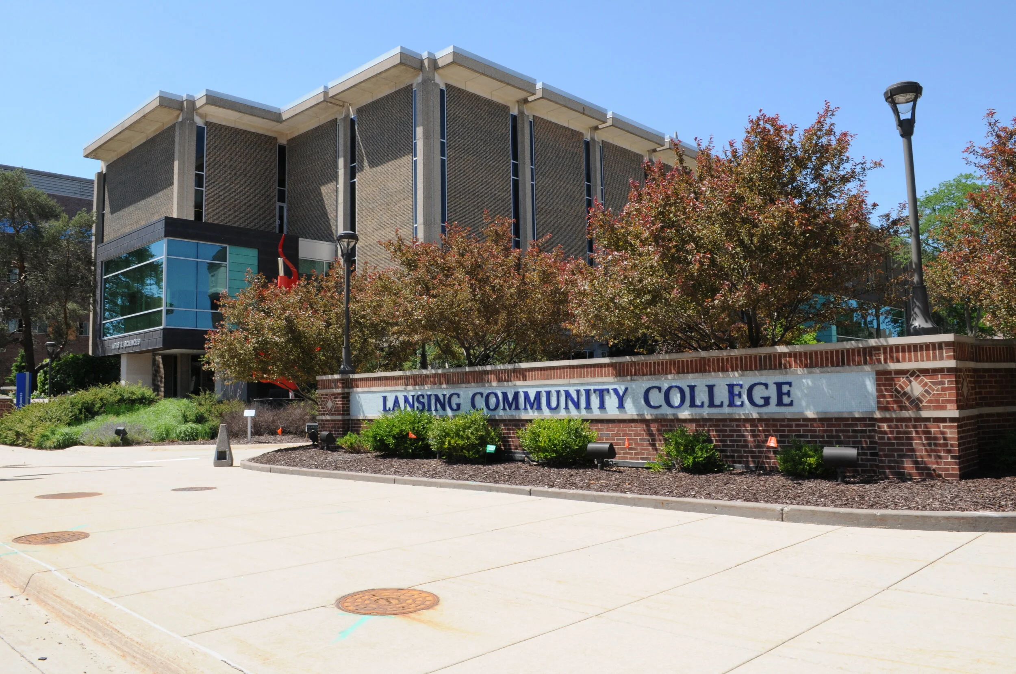
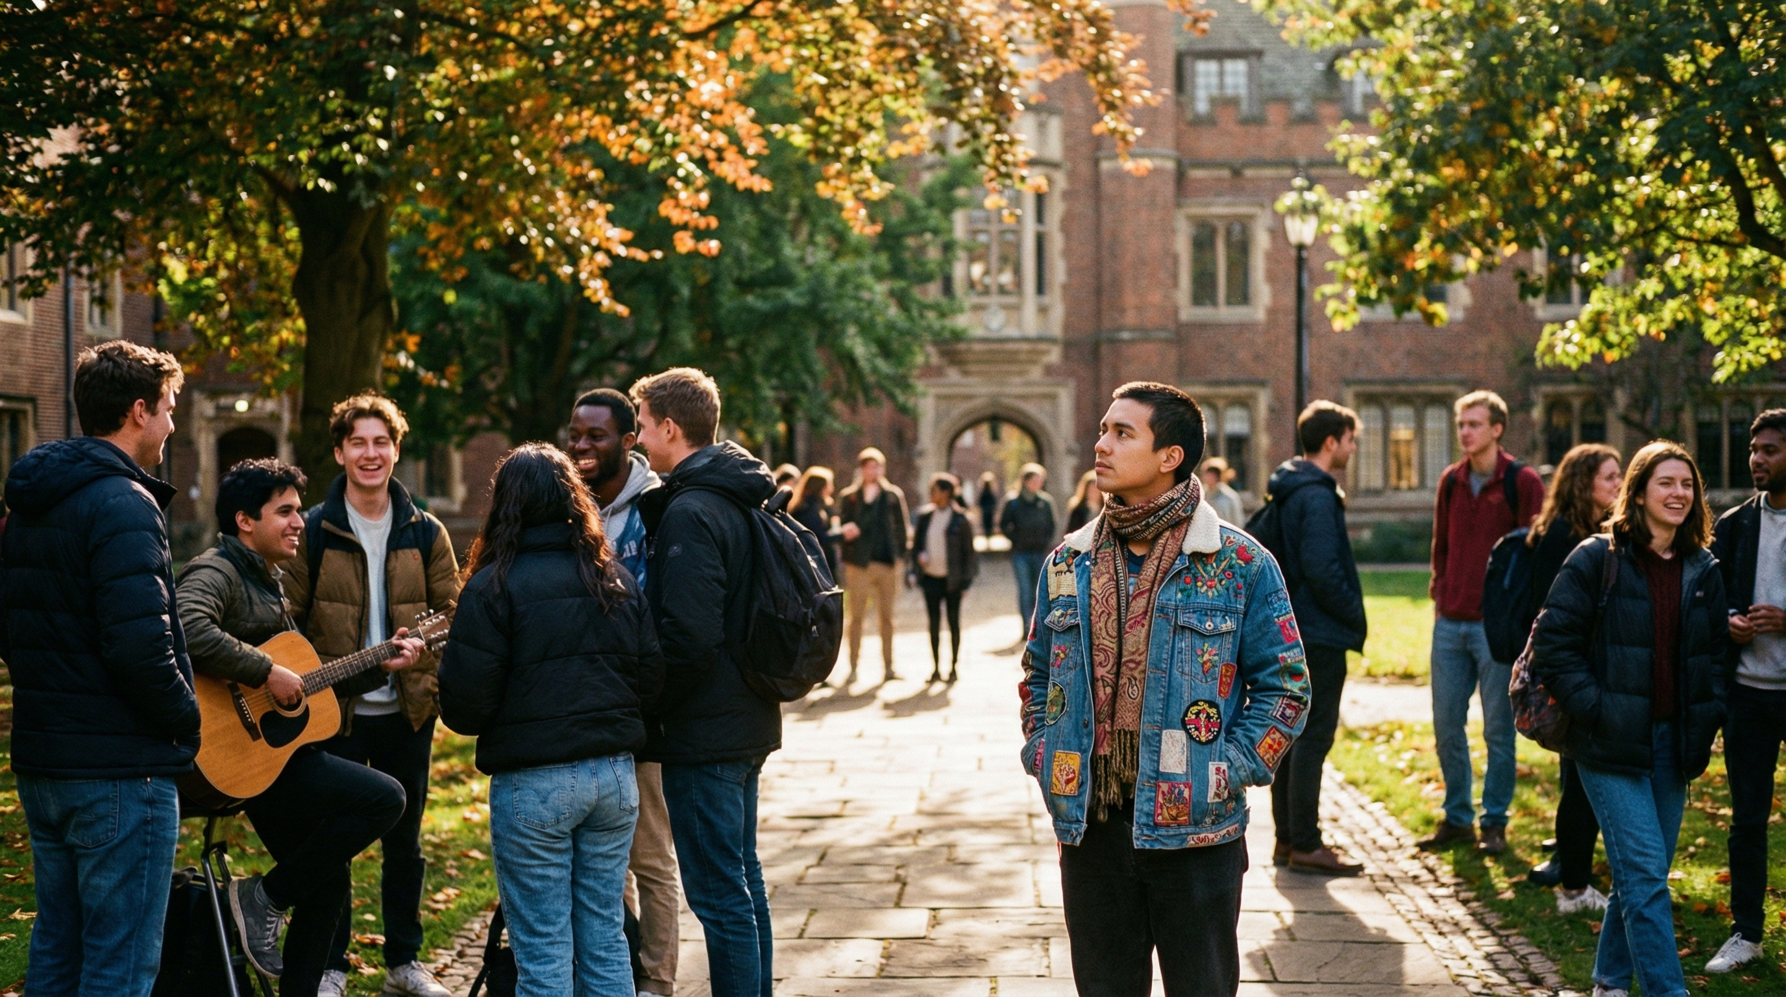



Think about a time you didn’t belong.
When the rules weren’t made for you.
When you had to work twice as hard.
That is their day
everyday
Notes:
I want you to think about something personal for a moment.
Think about a time in your life when you felt like you didn't belong, when the rules weren't made for someone like you. When you had to work twice as hard as everyone else just to keep up. When you looked around and wondered, "am I the only one struggling with this?"
Maybe it was your first day at a new job. Maybe it was learning a new technology that everyone else seemed to grasp instantly. Maybe it was walking into a room where you were the only person who looked like you, talked like you, and thought like you.
Remember that feeling.
Now imagine living that feeling every single day. In every class. In every interaction. In every space on campus.
That's the reality for many neurodivergent students.
Not because they can't learn. Not because they're not smart enough or capable enough. But because the environment wasn't designed with them in mind.

Slide 3

MISSION STATEMENT
Lansing Community College provides accessible, high-quality education through relevant and innovative instructional methods to equip and empower a diverse community of learners to complete their educational goals.
Notes:
"Lansing Community College provides accessible, high-quality education through relevant and innovative instructional methods to equip and empower a diverse community of learners to complete their educational goals."
That's our mission statement. And I believe we mean it.
But let's sit with those words for a moment. Accessible. Diverse community. Equip and empower.
Here's the question: When we say "accessible," do we mean accessible to every kind of learner? When we say "diverse community," does that include cognitive diversity? When we say "equip and empower," are we doing that for students whose brains work differently?
This isn't about whether we've been failing. Many of you are already living this mission every single day in your classrooms and offices.
This is about asking: How do we make sure this mission reaches every student who walks through our doors?
Because that's who we say we are. And that's who we want to be.

Slide 4

THE RESULTS ARE CLEAR
Autistic students experience poorer outcomes in higher education.
There's not a whole lot of small nooks you can retreat to without feeling like everyone is watching you.
It would be nice to feel accepted for the way I am, and not put in a box as someone who has a problem, but someone who might just learn differently than others.
Notes:
This isn't theoretical. The research is clear.
Multiple studies document that autistic students experience poorer outcomes in higher education compared to their neurotypical peers. They're more likely to report social isolation, mental health challenges, and difficulties navigating unstructured academic environments. Their graduation rates lag behind not just all students, but even students with other disabilities.
These are some quotes from our students:
One student mentioned, "There's not a whole lot of small nooks you can retreat to without feeling like everyone is watching you."
We can fix this with intentionally designed spaces.
Another student told us: "It would be nice to feel accepted for the way I am, and not put in a box as someone who has a problem, but someone who might just learn differently than others."
And this one stayed with me: "Just be patient! Especially when someone's trying to figure out how to word a question."
And here's the remarkable thing the research tells us: These outcomes aren't because of lack of ability. They're because of environments that fail to meet the needs of students with diverse cognitive, sensory, and communication needs.
When we create supportive environments, neurodivergent students don't just survive. They thrive.
So this isn't about fixing a crisis. This is about seizing an opportunity.
An opportunity to become the kind of institution where every student can show us what they're truly capable of.
That's worth investing in.

Slide 5



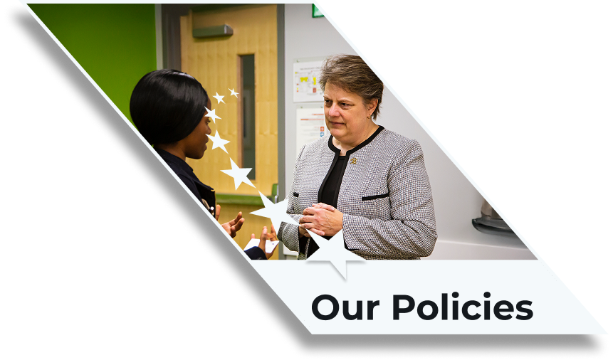
WE DESIGN
WITH INTENTION
Notes:
So how do we actually live out this belief? How do we make LCC a place where every kind of mind can flourish?
Not through special treatment. Not through separating students into categories. But through intentional design and continuous learning.
We design our physical spaces with sensory needs in mind; not as an afterthought, but from the beginning.
We design our teaching with flexibility built in; not because some students need accommodation, but because all students learn differently.
We design our policies and practices to include rather than exclude.
The beautiful thing about it is this: When we design for the students at the edges, everyone benefits. Just like when redesigning our college website or online courses to meet ADA standards, they became easier to use, search, and navigate for all users. Or how, a decade earlier, building wider doorways and entry ramps made campus buildings easier to navigate.
Clear instructions help all students. Flexible assessment options let everyone show what they know. Quiet spaces like the Technology and Learning Center serve anyone who needs to focus.
We're not lowering standards. We're removing barriers.

Slide 6
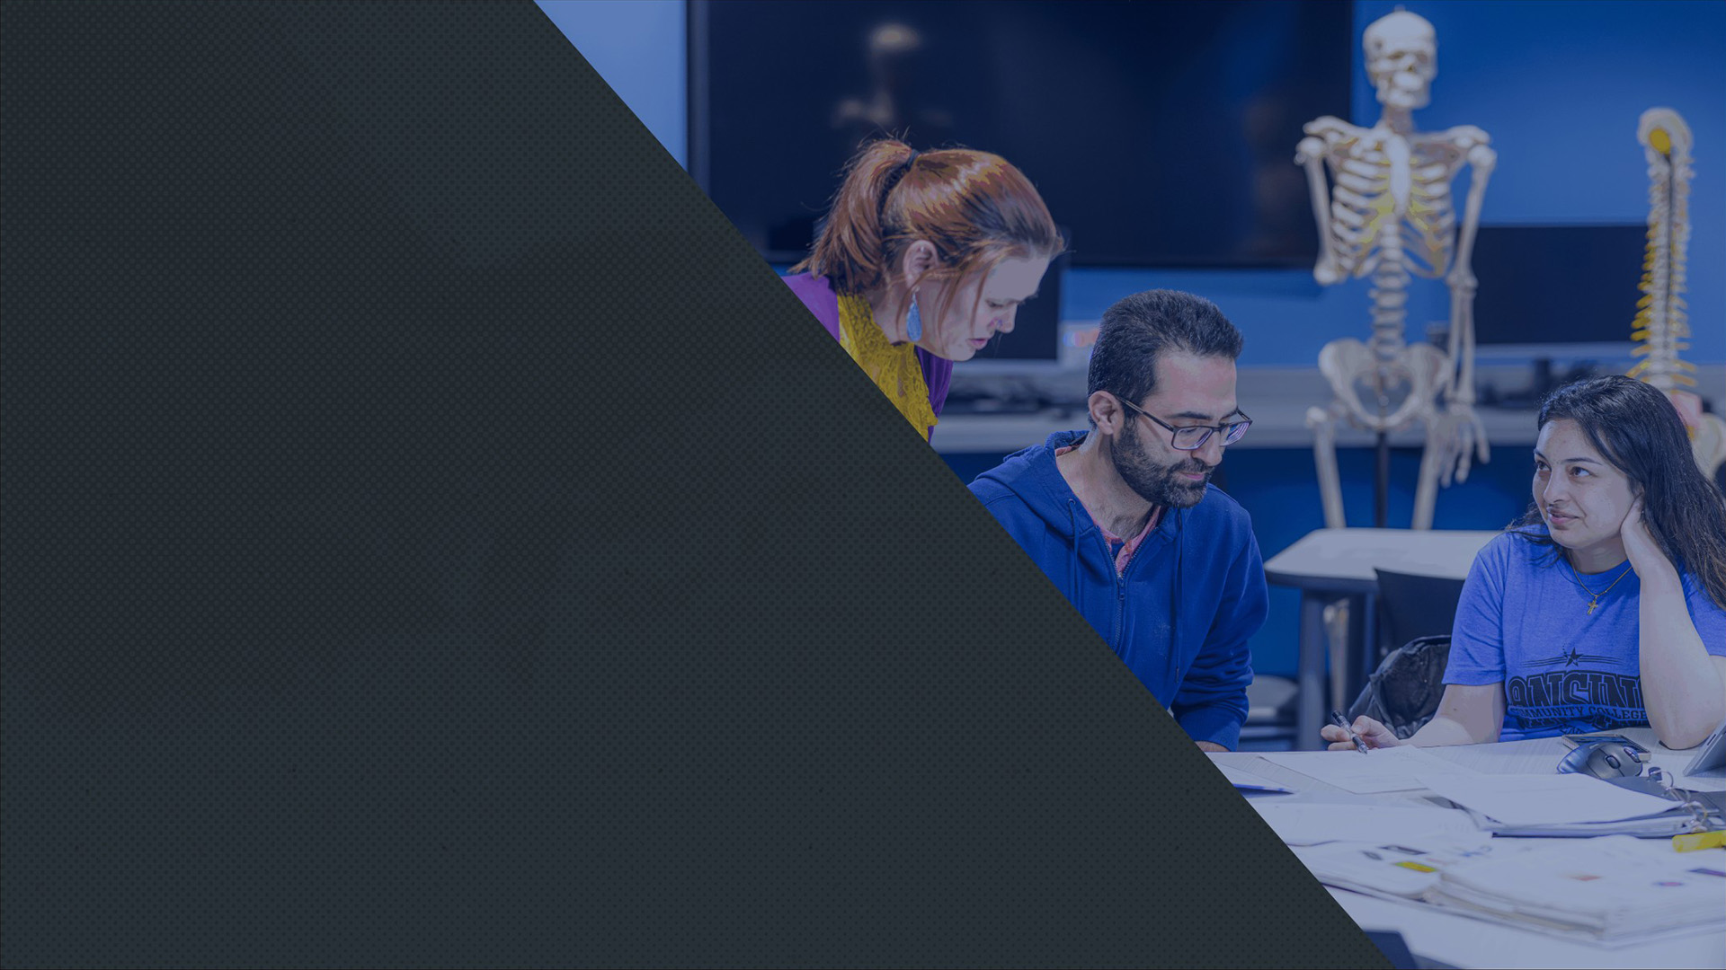



LCC likely already has a more autism-inclusive sensory environment than the majority of higher education institutions.
Dr. Lalor – Landmark College
Notes:
Here's something you should know: We're not starting from scratch.
We asked proven experts to assess where we stand. Landmark College is the first institution of higher education specifically designed for neurodivergent students; they have 40 years of experience in this work.
And you know what they told us?
Dr. Lalor from Landmark stated that LCC likely “already has a more autism-inclusive sensory environment than the majority of higher education institutions.”
Read that again. We're already ahead of most colleges in the country.
Our Technology and Learning Center? The report specifically notes it "incorporates a number of features that exemplify sensory-friendly design." Our quiet study spaces, our variety of seating, our meditation room, our ongoing transition to LED lighting. These are things colleges nationwide are trying to figure out, and we're working to improve these things.
So, again: this isn't about becoming something we're not. This is about becoming more of what we already are, making it a part of LCC’s DNA.

Slide 7


WE DID THE HOMEWORK
15
Focus Group
107
Participants
110
Surveys
Notes:
We didn't just bring in outside experts. We asked you. We asked our students, our faculty, our staff.
Landmark conducted 13 on-campus focus groups, 2 virtual focus groups, and surveys. 107 people participated in focus groups. 110 people completed surveys.
And the message was overwhelming:
You believe in this work.
When students and faculty groups were asked if LCC should provide a more autism-friendly campus, the most common response from all groups was "strongly agree." Neurodivergent students averaged 4.02 out of 5. Faculty showed even stronger agreement, averaging 4.33 out of 5. And the highest level of agreement came from Neurotypical students, who averaged 4.39 out of 5.
This means there is wide consensus that autism-friendly initiatives benefit our entire LCC community. You already believe what we believe. You're already living these values in your classrooms, in your offices, in your interactions with students every single day.
Now we're just making it official. We're making it systematic, and sustainable.

Slide 8
YOU GAVE FEEDBACK
80%
Neurodivergent Student
Approval
88%
Neurotypical Student
Approval
87%
Faculty
Approval
Notes:
We didn't just bring in outside experts. We asked you. We asked our students, our faculty, our staff.
Landmark conducted 13 on-campus focus groups, 2 virtual focus groups, and surveys. 107 people participated in focus groups. 110 people completed surveys.
And the message was overwhelming:
You believe in this work.
When students and faculty groups were asked if LCC should provide a more autism-friendly campus, the most common response from all groups was "strongly agree." Neurodivergent students averaged 4.02 out of 5. Faculty showed even stronger agreement, averaging 4.33 out of 5. And the highest level of agreement came from Neurotypical students, who averaged 4.39 out of 5.
This means there is wide consensus that autism-friendly initiatives benefit our entire LCC community. You already believe what we believe. You're already living these values in your classrooms, in your offices, in your interactions with students every single day.
Now we're just making it official. We're making it systematic, and sustainable.

Slide 9


WHAT WORKS
WHAT DOESN’T
Inclusivity
Helpful staff and faculty
Quiet spaces
Academic support
Lighting
Overstimulating classrooms
Resource Accessibility
Jordan
Overwhelmed
Struggling
Ready to quit
Notes:
Our students told us what's working. They appreciate the inclusivity. They value how helpful our staff and faculty are. They love the quiet spaces and academic support.
But they also told us where they struggle.
Lighting can be overwhelming. Classroom environments can be overstimulating. They don't always know what resources exist or how to access them.
They're not complaining. They're trusting us with the truth.
They're saying: "We want to succeed here. We want to be part of this community. Here's what we need." Autistic students aren’t lacking potential, they’re navigating a system built without them in mind.
When students trust you enough to tell you what they need, listening is not optional.
Let me share another example.
A student I’ll call Jordan, arrived on campus excited for their first semester. They had done all the prep work. Read the syllabus twice. They walked their schedule the day before. They were ready.
But when they stepped into the hallway outside their first class, they froze. The noise. The crowds. The sudden shift from quiet planning to chaotic reality. Their brain went from organized to overwhelmed in seconds.
So they did what many students do in that moment. They masked. They tried to push through. They sat in class pretending to follow every word, even though their nervous system was already in fight or flight.
After class, they wanted to ask the instructor a clarifying question, but the idea of standing in that line of loud, chit-chatting students felt impossible. So they left. And the question remained unasked.
Jordan wasn’t struggling academically. They were struggling environmentally.
And campuses everywhere have Jordans, brilliant students navigating systems never designed with them in mind.

Slide 10

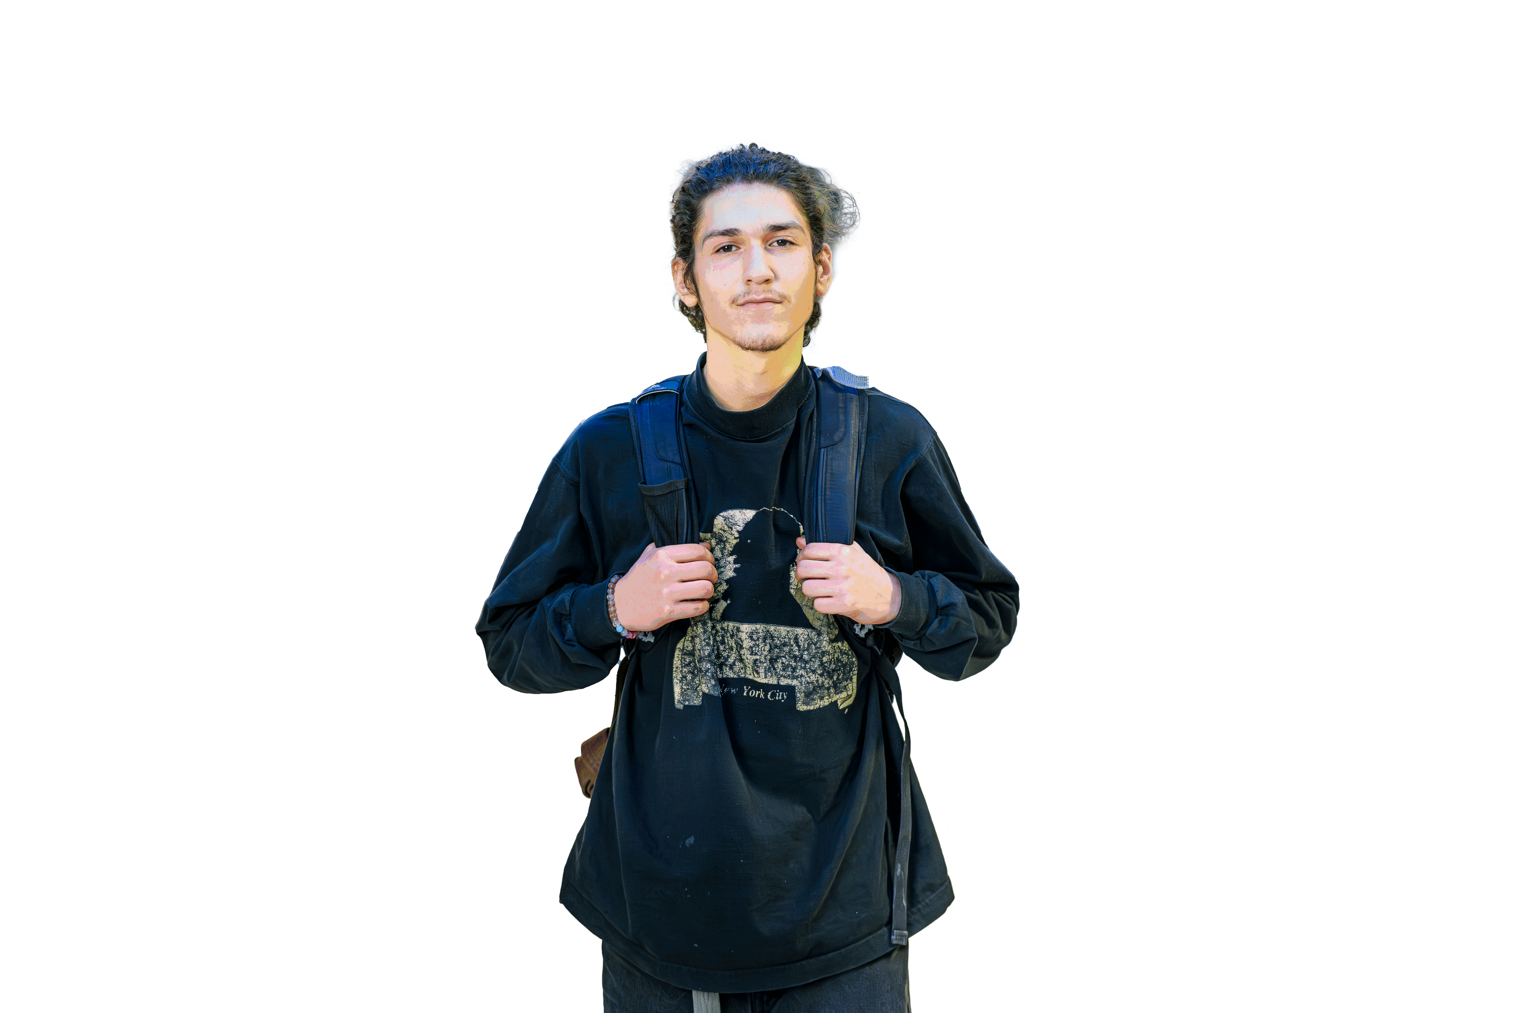
FACULTY & STAFF
WE HEARD YOU
We will provide the
Training
Strategies
Tools
Notes:
And you, our faculty and staff, you told us something equally important.
You told us you want to support these students. You recognize the value of neurodiversity. You understand that this aligns with our mission.
But you also told us the truth: You need more training. You need practical strategies. You're saying: "We want to do this work well. Give us the tools."
The report documents a "strong call for structured professional development and training to better support neurodivergent learners."
That's exactly what we're going to do.

Slide 11
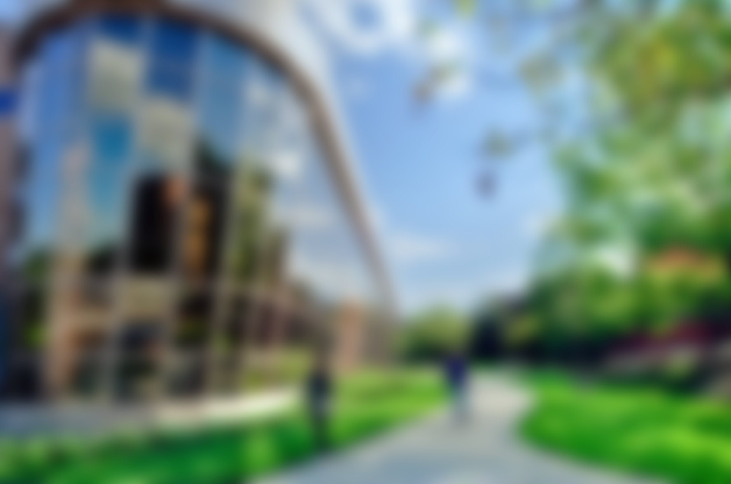

IMAGINE
Clear Structure
Adjustable Lighting
Safe Places
Confident Faculty
New Strategies
Graduation
Notes:
Imagine a student walking into their first class, and the syllabus is organized the way their brain actually processes information. Clear expectations. Predictable structure. No guessing games.
Imagine classrooms with adjustable lighting options. Spaces with predictable sensory input instead of “hope for the best.”
Imagine a student getting overwhelmed during a busy day and knowing exactly where to go to decompress, a quiet space with dimmable lighting and comfortable seating, designed for exactly that purpose.
Imagine faculty who feel confident, not overwhelmed, because they’ve been trained with practical, research-backed strategies that work for all learners.
Imagine a faculty member applying intentionally designed strategies in their classroom and watching engagement increase across the board, not just for neurodivergent students, but for everyone.
Imagine a neurodivergent student graduating, not despite our environment, but because of it.
That's the institution we're becoming.

Slide 12


YEAR 1 FOUNDATION
YEAR 2+3 SKILLS
YEAR 4 STUDENT LEADERSHIP
YEAR 5 SUSTAINABILITY
Start the conversation. Build awareness.
Bring in expert leadership.
Create and train champions.
Translate awareness into practical action.
Make systemic changes. Update policies.
Embed neurodiversity into onboarding and review.
Center neurodivergent voices.
Create peer support networks.
Empower students to lead.
Start the conversation. Build awareness.
Bring in expert leadership.
Create and train champions.
Result: Key leaders in place. Campus-wide
awareness established.
Result: Increased competency. Support networks established. Improved belonging.
Result: Increased engagement and retention. Student ownership established.
Result: Clear metrics. Sustainable integration. Continuous improvement.
Notes:
Landmark gave us a five-year plan to get there. It's thoughtful. It's practical. It's achievable. Here’s what this looks like when we do it together with intent.
Year 1: Foundation. We start the conversation. We build awareness. We bring in expert leadership. We create, educate, and train a team of campus champions.
The Result: Having key leaders and champions for the initiative, the right people in place to make a difference. Shared campus-wide awareness and basic understanding of autism and neurodiversity.

Slide 13
YEAR 1 FOUNDATION
YEAR 2+3 SKILLS
YEAR 4 STUDENT LEADERSHIP
YEAR 5 SUSTAINABILITY
Start the conversation. Build awareness.
Bring in expert leadership.
Create and train champions.
Translate awareness into practical action.
Make systemic changes. Update policies.
Embed neurodiversity into onboarding and review.
Center neurodivergent voices.
Create peer support networks.
Empower students to lead.
Start the conversation. Build awareness.
Bring in expert leadership.
Create and train champions.
Result: Key leaders in place. Campus-wide
awareness established
Result: Increased competency. Support networks established. Improved belonging.
Result: Increased engagement and retention. Student ownership established.
Result: Clear metrics. Sustainable integration. Continuous improvement.
Notes:
Year 2: Skills. We translate awareness into action. We give you practical strategies for your specific role. We create helpful resources you can use. Structure. We make systemic changes. We improve our spaces. We update our policies. We embed neurodiversity into how LCC operates. We build neurodiversity into new employee onboarding and faculty review.
The Result: Increased competency in supporting autistic and neurodivergent students. Establishment of support networks and resources across our campuses.
Improved sense of belonging for neurodivergent students, faculty, and staff. More inclusive policies that reflect the needs of autistic individuals and clearly convey our expectation of what modern researchers call “neuro-inclusion.”

Slide 14
YEAR 1 FOUNDATION
YEAR 2+3 SKILLS
YEAR 4 STUDENT LEADERSHIP
YEAR 5 SUSTAINABILITY
Start the conversation. Build awareness.
Bring in expert leadership.
Create and train champions.
Translate awareness into practical action.
Make systemic changes. Update policies.
Embed neurodiversity into onboarding and review.
Center neurodivergent voices.
Create peer support networks.
Empower students to lead.
Start the conversation. Build awareness.
Bring in expert leadership.
Create and train champions.
Result: Key leaders in place. Campus-wide
awareness established
Result: Increased competency. Support networks established. Improved belonging.
Result: Increased engagement and retention. Student ownership established.
Result: Clear metrics. Sustainable integration. Continuous improvement.
Notes:
Year 3 and 4: Student Leadership. We center neurodivergent voices. We create peer support networks. We empower students to lead.
The Result: Increased student engagement, ownership, and sense of belonging. Development of long-term leadership capacity within the student body. Improved neurodivergent student retention and/or enrollment.

Slide 15
YEAR 1 FOUNDATION
YEAR 2+3 SKILLS
YEAR 4 STUDENT LEADERSHIP
YEAR 5 SUSTAINABILITY
Start the conversation. Build awareness.
Bring in expert leadership.
Create and train champions.
Translate awareness into practical action.
Make systemic changes. Update policies.
Embed neurodiversity into onboarding and review.
Center neurodivergent voices.
Create peer support networks.
Empower students to lead.
Start the conversation. Build awareness.
Bring in expert leadership.
Create and train champions.
Result: Key leaders in place. Campus-wide
awareness established
Result: Increased competency. Support networks established. Improved belonging.
Result: Increased engagement and retention. Student ownership established.
Result: Clear metrics. Sustainable integration. Continuous improvement.
Notes:
Year 5: Sustainability. We evaluate our impact. We publish an annual Autism-Friendliness Report. We make sure this isn't a project that ends; it's who we are.
The Result: Clear metrics for success and areas for growth. Sustainable integration of autism-friendly practices into campus culture. Continuous improvement via annual reporting accountability.
This isn't a sprint. It's a commitment. Because creating a place where every student can belong doesn’t happen through one workshop or one policy tweak. It happens through steady, intentional change. Brick by brick. Choice by choice. By the end of these five years, students who once felt invisible will feel seen. Students who once questioned whether college was ‘for them’ will know without a doubt that it is.

Slide 16
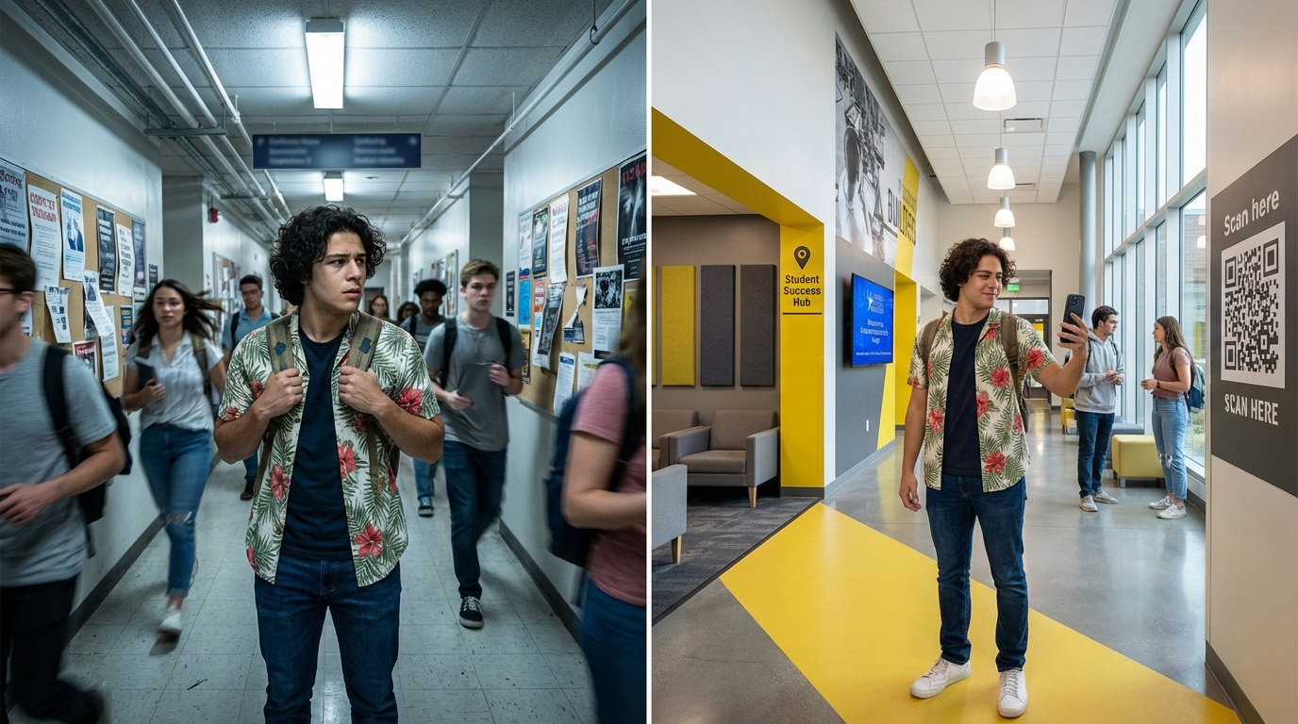
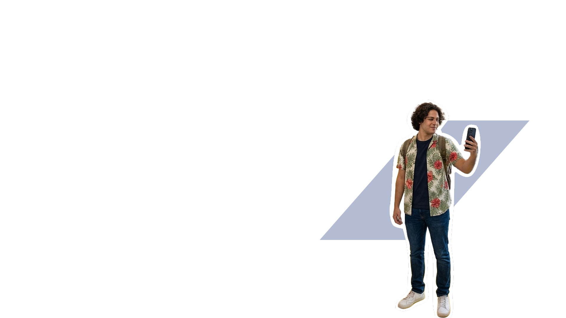

Notes:
Now, imagine that same student from earlier, Jordan, two years from now, on a campus built with inclusion at its core.
They walk into the same hallway, but this time it’s different. Clear signage. Predictable layouts. A quieter waiting space just down the hall. Faculty who are trained to communicate expectations upfront. A class culture where asking for clarity is normal, not nerve-wracking.
In this version of the story, Jordan still has a question after class. But instead of silently slipping out, they use a simple QR code posted by the door to submit it. The instructor answers it by the next morning. No pressure. No overstimulation. No barrier.
And for the first time, they feel like they can participate fully — not selectively, not cautiously — but fully.
Same student. Different environment. Completely different outcome.

Slide 17

WHAT WE
CAN DO NOW
Continue our
LED lighting
transition
Create a
centralized
resource website
Designate
low-sensory
spaces for
major events
Include
neurodiversity
in new
employee
orientation
Notes:
But we don't have to wait five years to start making a difference.
There are things we can do right now:
Continue our LED lighting transition - We're already doing this. Let's finish it.
Create a centralized resource website - One place where everyone can find information about supporting neurodivergent students.
Designate low-sensory spaces for major events - Give students options during orientation, graduation, and major campus gatherings.
Include neurodiversity in new employee orientation - Make sure everyone who joins LCC understands our commitment from day one.
These aren't expensive. They're not complicated. They're things we can start this semester.

Slide 18


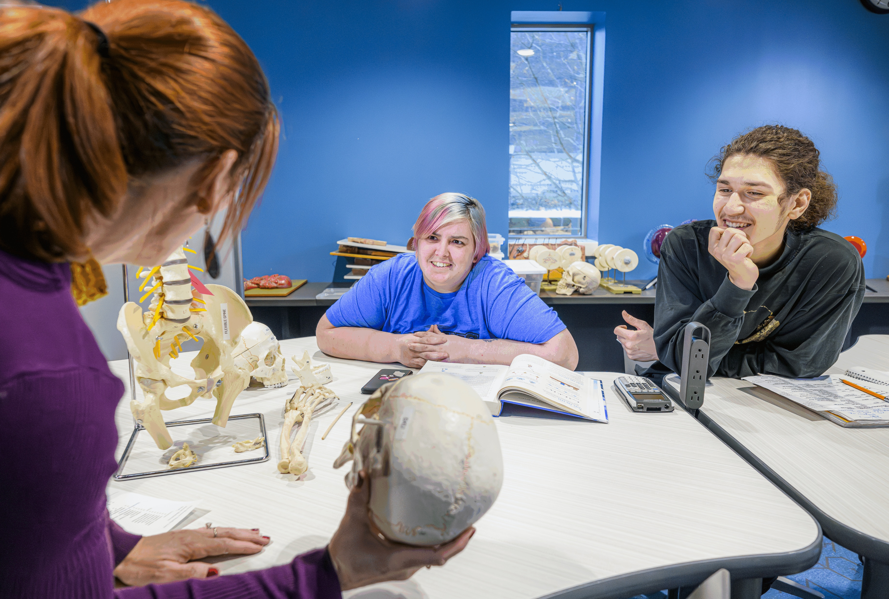
FACULTY
You didn't become an educator to teach to the middle and hope for the best.
STAFF
STUDENTS
You became an educator because you believe in unlocking potential.
You believe that teaching done right can change lives.
Notes:
For our faculty, let me connect this to why you chose this profession.
You didn't become an educator to teach to the middle and hope for the best. You became an educator because you believe in unlocking potential. You believe that teaching done right can change lives.
THIS is teaching done right.
The plan includes workshops on intentional design for Learning and practical classroom strategies. The report notes that Landmark's clients regularly call their training courses "transformative, practical, and among the best professional developments they have ever received."
You'll learn strategies that help neurodivergent students, and you'll discover they help all your students engage more deeply, understand more clearly, and demonstrate learning more authentically.
You're not adding more work. You're becoming a better instructor.

Slide 19
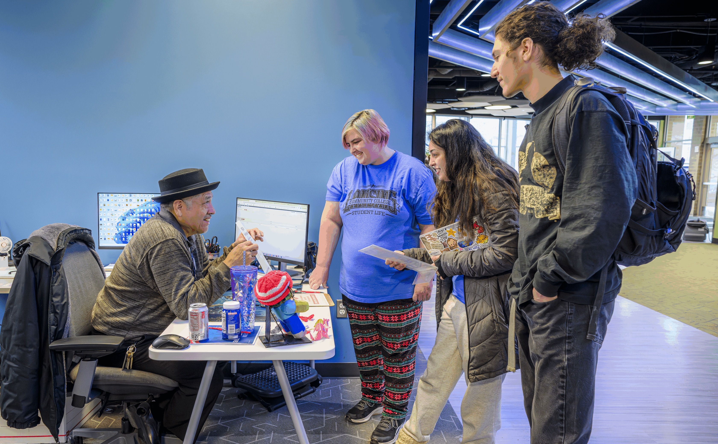
FACULTY
STAFF
Why did you choose to work at a community college instead of somewhere else?
STUDENTS
You believe in the mission.
You believe in opening doors.
Notes:
For our staff, whether you work in student services, facilities, public safety, IT, or administration, you know your role matters.
Let me ask you: Why did you choose to work at a community college instead of somewhere else?
Maybe it's because you believe in the mission. You believe in opening doors. You believe education should be accessible.
This is what accessibility looks like in practice.
The plan includes training tailored to your specific roles. You'll learn how your work, whether it's designing a space, responding to a crisis, or answering a phone call, contributes to a campus where every student can succeed.
You make this campus run, which means for many students, you make accessibility real.

Slide 20
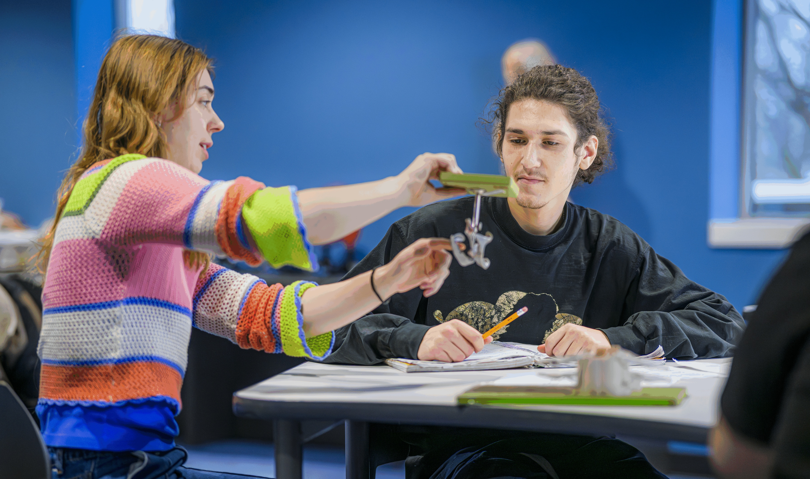
FACULTY
STAFF
You chose LCC to belong.
We want to make sure you were right.
STUDENTS
Neurodivergent students:
We want to hear from you. Lead panels.
Shape policies. Tell us what you need.
All students benefit:
Clearer communication. Better spaces. Flexible learning.
Notes:
For our students, whether you're neurodivergent or neurotypical, this is about making sure LCC works for you.
You chose LCC for a reason. Maybe for the programs. Maybe for the location. Maybe because it felt like a place where you could belong.
We want to make sure you were right.
If you're neurodivergent, we want to hear from you. The plan specifically calls for centering your voices. We want you leading panels, shaping policies, and telling us what you need.
If you're neurotypical, you benefit too. Clearer communication. Better study spaces. More flexible learning options. A campus culture that values different perspectives.
And here's something important: When you help create an inclusive environment, you're building skills you'll use for the rest of your life. Empathy. Flexibility. Design thinking. These things matter, both today, and wherever you end up.

Slide 21



ADDRESSING CONCERNS
Will training
be mandatory?
Do we have
the resources?
Will students
be singled out?
No
Integrated professional
development instead.
Yes
Costs vary, with many low- or no-cost options.
No
Universal design benefits everyone equally.
Notes:
I know some of you are thinking: "This sounds great, but..."
"But will this be mandatory training that feels like a waste of time?" "But do we really have the resources?" "But will this single out students who don't want to be singled out?"
Let me address those fears directly.
On mandatory training: The report specifically recommends against the kind of mandatory training that creates resistance. Instead, it suggests building professional development into existing systems, new hire orientation, department meetings, and tenure review. The report states that "mandating training can lead to resistance and frustration" and recommends offering "choice, variety, and connection to common goals."
On resources: The plan provides recommendations at three cost levels, so we can prioritize based on what's realistic. Many recommendations are low-cost or no-cost.
On singling students out: This design philosophy means building accessibility in from the start. When everyone has options, no one is singled out.
These concerns are valid, and the plan addresses them thoughtfully.

Slide 22
DO WE BELIEVE
What we say we believe?
Education should be accessible to every student?
Different isn't less?
LCC exists to empower all learners?
If we believe what we say, this is simply living our values.
Notes:
Here's what it comes down to:
Do we believe what we say we believe?
Do we believe education should be accessible to every student? Or only to students whose brains work a certain way?
Do we believe different isn't less? Or do we believe there's a "right way" to learn and everyone else just needs to try harder?
Do we believe LCC exists to empower all learners? Or do we mean "all learners who can succeed in the environment we've already created"?
Because if we believe what we say we believe, all of this that we’re talking about today is simply delivering on our commitments, and living our values.

Slide 23

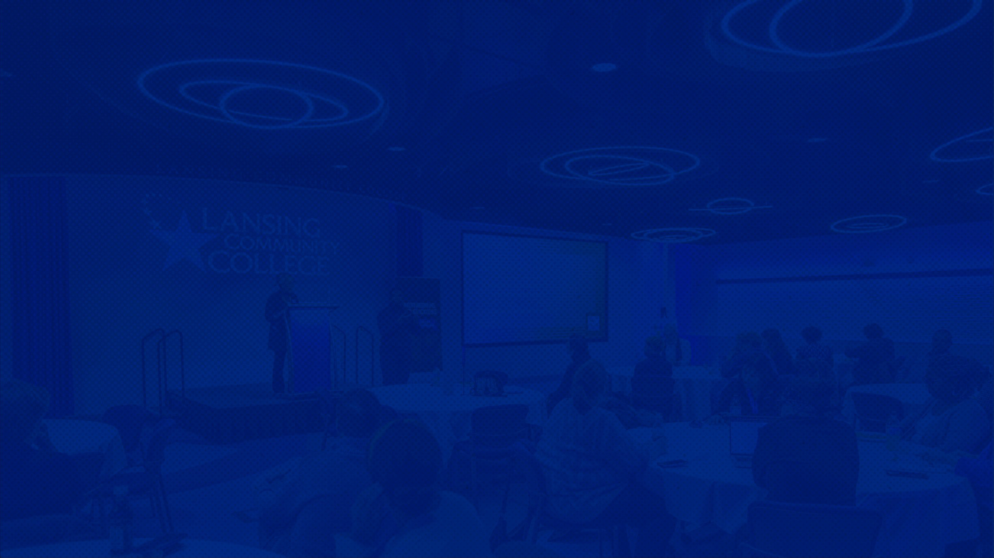
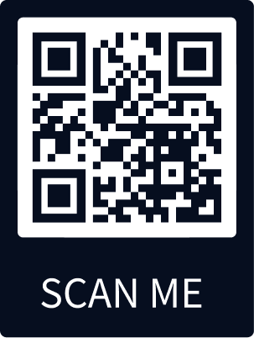
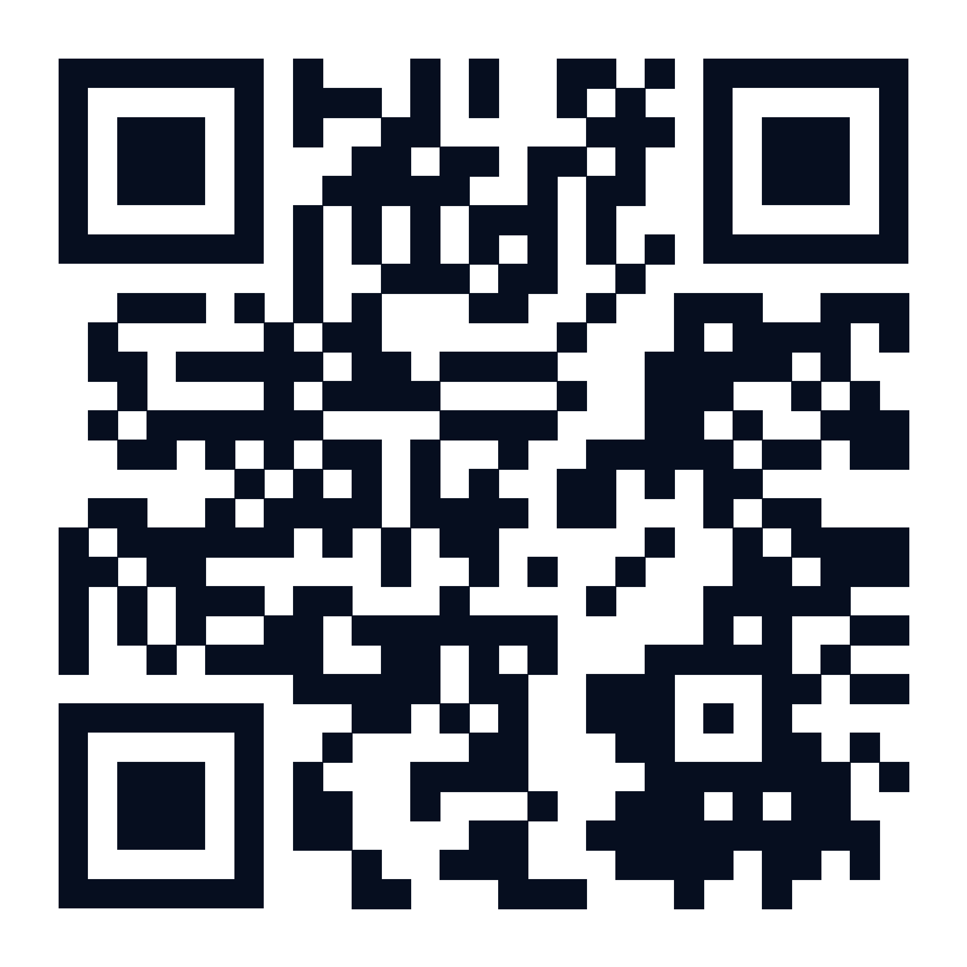
JOIN US
Every student deserves to thrive.
Different isn’t less.
Success should be within reach.
Will you be part of building the
institution we say we are?
Notes:
So here's my invitation to you:
If you acknowledge that every student deserves the opportunity to thrive, that different isn't less, and that our job is to remove barriers rather than ask students to overcome them, then join us.
Because you believe it too.
In the coming weeks, we'll share more details. We'll identify opportunities to get involved. We'll begin Year 1 of the plan.
But today, right now, I'm asking you to make a decision.
Will you be part of building the institution we say we are?

Slide 24


IN FIVE YEARS
Parents:
"LCC gets it. You'll be okay there.“
Students:
"I'm going to LCC. I can succeed.“
Faculty:
"I can't imagine teaching any
other way.“
Graduates:
Succeed at the same rate.
Barriers removed.
Notes:
Five years from now, here's what success looks like:
A parent tells their child who struggled in school, "LCC is a place that gets it. You'll be okay there."
A prospective student with autism is choosing between colleges and says, "I'm going to LCC because I know I can succeed."
A faculty member teaches a diverse classroom using Universal Design principles and thinks, "I can't imagine teaching any other way."
A neurodivergent student graduates from LCC at the same rate as their peers. Not due to giving anyone special treatment, but because we removed the barriers that had nothing to do with an individual’s academic ability.
That's what we're building. A community where every kind of mind can flourish.

Slide 25
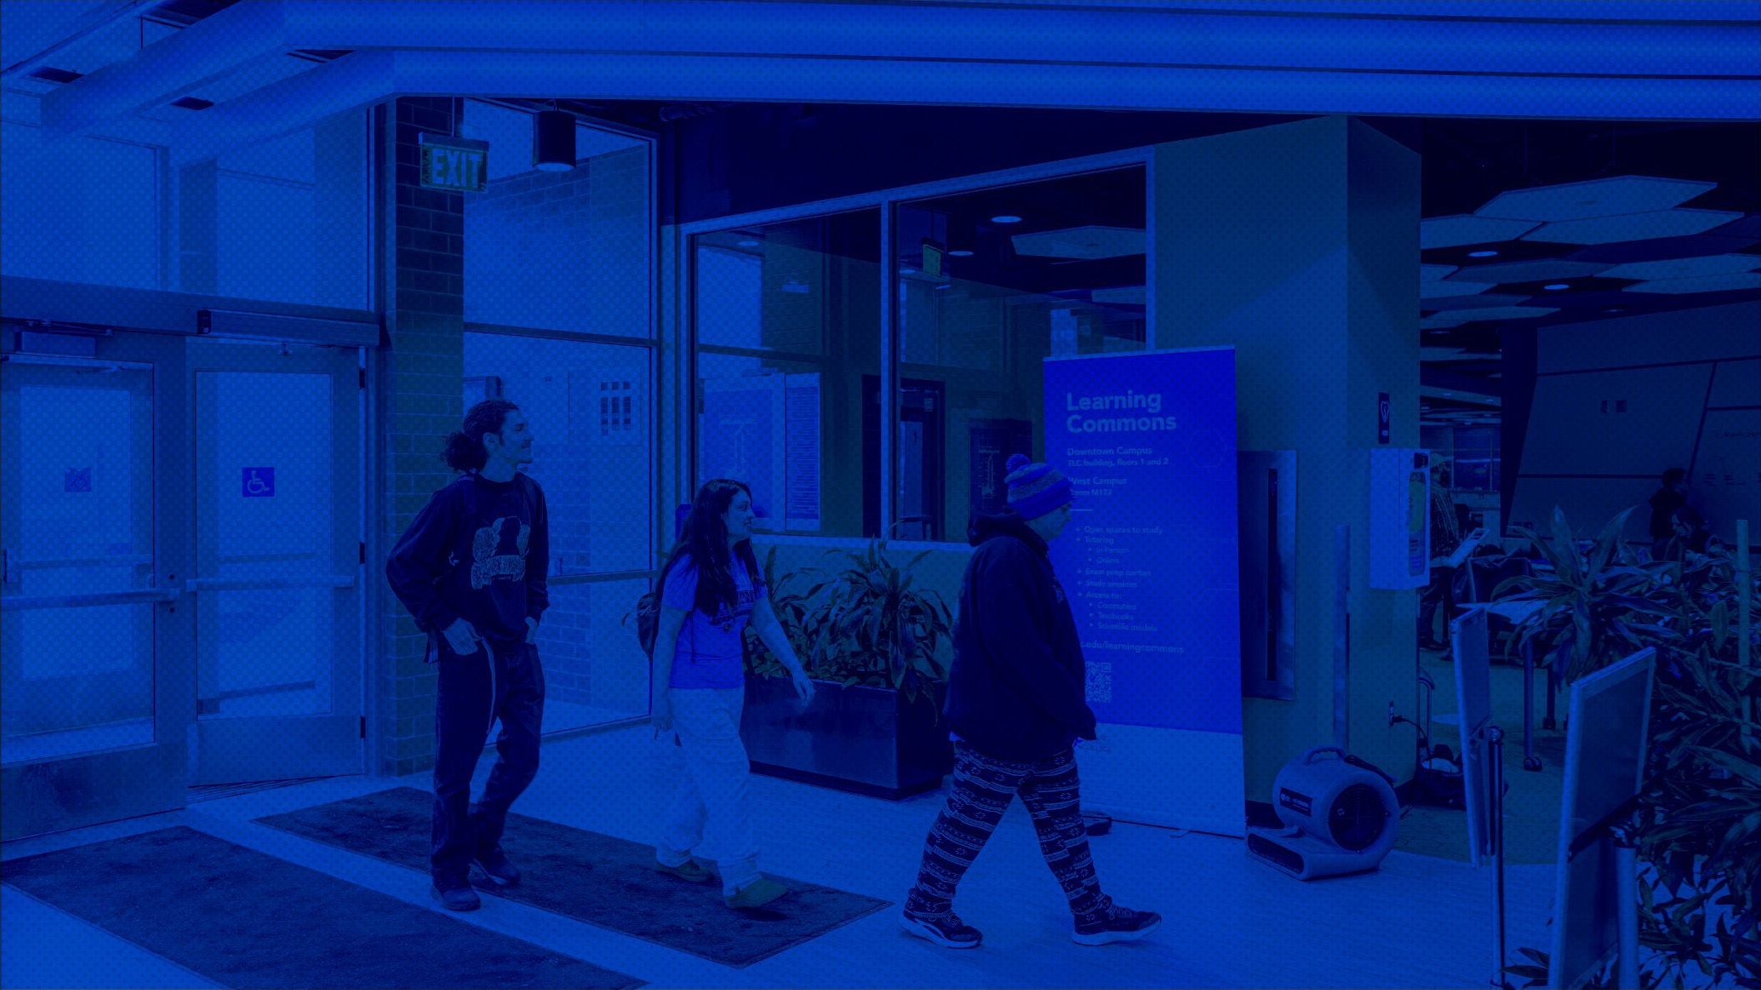
THANK YOU
Notes:
We started with a belief.
We believe every student deserves the opportunity to thrive.
We believe that when we design environments that work for the students at the edges, everyone benefits.
We believe that LCC's mission to empower learners, to transform lives, to serve our community, means all learners. All lives. Our entire community.
We're not becoming something different. We're becoming more of who we already are.
Thank you for being here. Thank you for believing. Thank you for building this with us.
Now let's talk about what questions you have and how we move forward together.

