Slide 1
Agenda
Introduction + Recap of project goals
Guiding questions
Methodology + Findings
Community Input (Method 1)
Findings (overview)
Sensory audits (Method 2)
Findings (overview)
Recommendation (Deeper Dive): Professional Development
Q&A
Final Thoughts

Slide 2
(Re) Introduction + Goals

Slide 3


Who are we?
Established in 2001 to research, develop, and disseminate Landmark College’s best practices for neurodivergent students.
Notes:
Include brief intros by each of the LCIRT facilitators (Rick, Adam, Emily)

Slide 4

What were the project goals?
Define what IS an autism-friendly campus
Identify and collect information from multiple sources/stakeholders across LCC
Analyze data for key themes and emerging trends
Compile key findings of this study with LCIRT knowledge of best practices
Distill into recommendations
Notes:
Focus groups:
an index of crucial vocabulary to be utilized and incorporated into our campus culture.
Determine how to best identify students with autism tendencies.
Define specifically what an autism-friendly campus looks like.
Glean insight on what steps are necessary to create a most-inclusive learning environment for persons with autism tendencies.
Identify what steps are applicable to this campus.
For each applicable step, provide a breakdown of how implementation could be accomplished. This breakdown includes all required resources, a timeline, tasks, and evaluation instruments along the way. This breakdown will also identify overall strengths, weaknesses, opportunities, and threats associated with moving forward.
Create a Professional Development Plan for LCC faculty and staff.
Generate a report to share all aspects of the project from beginning to end.

Slide 5
Methodology + Findings

Slide 6
Method 1: Community Input

Slide 7
What is neuro-diversity and why should LCC embrace it?
01
What is going well? What current supports are available?
02
What are the additional future needs?
03
Guiding Questions
Notes:
2a. Are physical spaces on campus autism/neurodivergent-friendly?
2b. Is instruction x for diverse learners?
3a. What programs, staffing, or additional resources would need to be created or
expanded to further support autistic/neurodivergent students on campus? What
steps are most crucial?
3b. What professional development trainings or resources are needed for faculty and
staff to better support autistic/neurodivergent students at LCC?

Slide 8
Method 1: Community Input
What | Purpose + Description | Participants/Number
Focus Groups (Method 1a) | Semi-structured Qualitative Aim: deep insights into experiences, perceptions, and recommendations. | 13 on campus; 2 virtual 107 LCC faculty, staff, and students
Surveys (Method 1b) | Purpose + aim same as focus groups Allowed asynchronous access | 75 Students 35 Faculty/Staff
Notes:
A set of questions was created and iterated to use as guiding questions during on campus
semi-structured focus groups with various LCC stakeholders. Focus groups allow us to gain in-
depth qualitative insights into key project questions through interactive discussions with small
groups from similar cohorts at LCC. In short, these allow us to gain an understanding of LCC
stakeholders' experiences, perceptions, behaviors, attitudes, and decisions around the autism-
friendly initiative.
Surveys were also distributed that asked key project questions, along with some basic
demographic questions. Employing this format allowed for varied response options, enabling
greater flexibility and accessibility to stakeholders; in other words, it allowed for participants to
respond that could not otherwise have attended an in person focus group due to time
constraints, response preference, or social anxiety.

Slide 9
What is neuro-diversity and why should LCC embrace it?
01
What is going well? What current supports are available?
02
What are the additional future needs?
03
Guiding Questions
Notes:
2a. Are physical spaces on campus autism/neurodivergent-friendly?
2b. Is instruction x for diverse learners?
3a. What programs, staffing, or additional resources would need to be created or
expanded to further support autistic/neurodivergent students on campus? What
steps are most crucial?
3b. What professional development trainings or resources are needed for faculty and
staff to better support autistic/neurodivergent students at LCC?

Slide 10
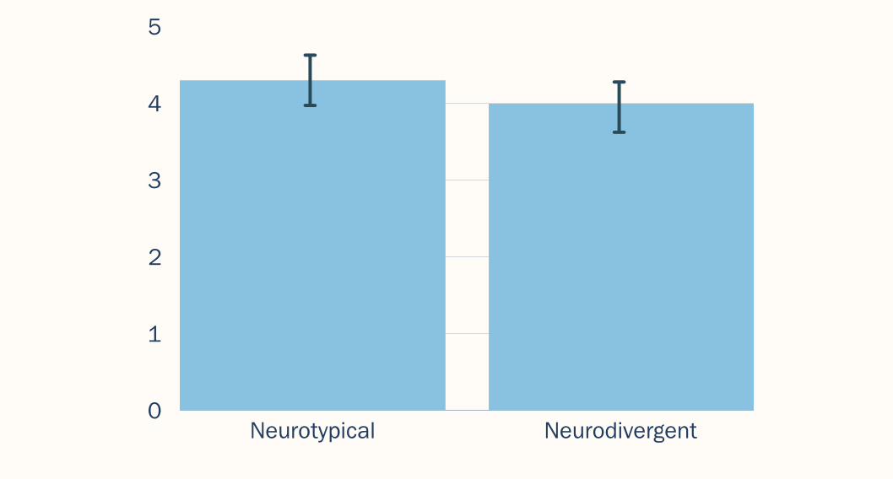
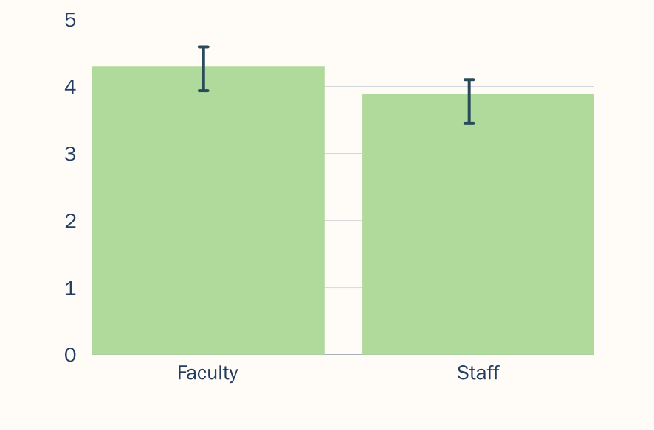
Findings: Q1-Should Embrace ND?
Should LCC provide a more autism friendly campus?
Notes:
>> Awareness + Training

Slide 11
What is neuro-diversity and why should LCC embrace it?
01
What is going well? What current supports are available?
02
What are the additional future needs?
03
Guiding Questions
Notes:
2a. Are physical spaces on campus autism/neurodivergent-friendly?
2b. Is instruction x for diverse learners?
3a. What programs, staffing, or additional resources would need to be created or
expanded to further support autistic/neurodivergent students on campus? What
steps are most crucial?
3b. What professional development trainings or resources are needed for faculty and
staff to better support autistic/neurodivergent students at LCC?

Slide 12
Findings: Q2. –Available Supports
Many students appreciate the quiet study spaces and the support from academic services.
Some students are aware of resources (e.g., accommodations and quiet study areas) there is a reported lack of awareness about other available support services.
Some students face challenges due to a perceived lack of understanding and empathy from some faculty and staff.
"I think that LCC as a whole does a great job being inclusive. Staff and faculty are very welcoming and genuinely want to help students.
“...everyone I have spoken to… are very helpful and kind! Even without knowing that I have Autism…”
Notes:
Issues such as
overstimulating lighting, distracting noise, and physical
discomfort in classrooms are common concerns. Many
students are unaware of existing support services, suggesting
a need for better promotion and accessibility of these
resources.

Slide 13
What is neuro-diversity and why should LCC embrace it?
01
What is going well? What current supports are available?
02
What are the additional future needs?
03
Guiding Questions
Notes:
2a. Are physical spaces on campus autism/neurodivergent-friendly?
2b. Is instruction x for diverse learners?
3a. What programs, staffing, or additional resources would need to be created or
expanded to further support autistic/neurodivergent students on campus? What
steps are most crucial?
3b. What professional development trainings or resources are needed for faculty and
staff to better support autistic/neurodivergent students at LCC?

Slide 14
Findings: Q3. Additional Needs - Students
Flexibility in Learning + Assessment
Clearer, simpler, organized instruction
Compassionate, patient, respectful faculty
"Students need and deserve more grace and help with their learning."
Notes:
>> Awareness + Training

Slide 15
Findings: Q3. Additional Needs - Students
Help ND students organize
Listen to ND students
ND Student Voice and Advocacy
mentoring, advocacy, clubs
"Help them [ND students] just 'be' themselves and know that's ok."
Notes:
>> Awareness + Training

Slide 16
Findings: Q3. Additional Needs – Faculty/Staff
Inclusive, supportive, flexible Instruction (training)
ND Awareness + understanding (training)
Clarity of access to existing resources

Slide 17
Method 2: Sensory Audits

Slide 18
Method 2: Sensory Audits
Goal: To support the comfortable and effective engagement of community members with sensory sensitivities on campus.
Definition​
Sensory Audits: Systematic evaluations of the sensory stimuli in each environment to identify potential barriers and opportunities for those who engage with that environment.

Slide 19
Sensory Audits - Procedure
Task
To systematically evaluate the sensory environment.
Sample Locations – 20 classrooms, offices, and social spaces (selected by LCC in communication with LCIRT staff)
Buildings included
Arts and Sciences Building
Gannon Building
Technology and Learning Center
Tool
Sensory Audit Evaluation Rubric
Guides evaluation of visual, auditory, and olfactory features of the sensory environment.
Uses observation as the primary method of data collection and a Tadeto Sound Level Meter used to measure decibel levels.

Slide 20
Sensory Audits – Summary of Findings
LCC likely already has a more autism-inclusive/neuroinclusive sensory environment than a majority of higher education institutions. Still, movement toward a more autism-inclusive and neuro-inclusive sensory environment should continue to occur over time as spaces, technologies, and people change.
— Adam R. Lalor, Ph.D.

Slide 21
Sensory Audits – Notable Findings
Already transitioning lighting from fluorescent to LED
Unoccupied, decibel readings across campus spaces were below or only slightly above levels considered to be auditory-friendly for neurodivergent people.
Nearly all spaces, with the exception of science spaces where odiferous materials were present (e.g., chemistry, biology), had very low, if any discernable odors.
Neutral and earthtone color choices were noted across LCC. The bright orange paint in the Arts & Sciences Building deviated from this trend.

Slide 22
Sensory Audits – Sensory-Friendly Exemplar
Technology and Learning Center
Features of sensory-friendly design identified.
Incorporation of a complementary color palette(cool colors)
White noise
Dimmable lighting
Varying textures in seating
Defined spaces for different purposes (while maintaining the open-concept design)
Presence of groupwork areas and individual spaces (e.g., cubbies) for study
Designated quiet areas

Slide 23
Sensory Audits – Recommendations
Continue investing in LED lighting (important to neurodivergent students)
Incorporate additional measures to reduce and absorb sound (e.g., plants, sculptural baffling)
Create low sensory spaces
Incorporate regular sensory audits into planning

Slide 24
Recommendations: Professional Development
A 5-Year Suggested Approach

Slide 25
5-Year Professional Development Plan
Goal: Use collected results/information to create a robust, achievable, and sustainable plan (set of steps) that contains options and suggestions to maximize success
Awareness and Foundations
Skill Development and Strategies
Policy and Environmental Design
Student Empowerment and Leadership
Sustainability and Evaluation

Slide 26
Year 1: Awareness and Foundations
Objectives:
Build foundational understanding of neurodiversity and autism
Gain institutional commitment
Establish and hire a Chief Neuro-Inclusion Officer
Identify a group of Neuro-Inclusion Champions (experts) from each key area on campus
Begin a neurodivergence and autism awareness campaign with one introductory webinar/workshop per semester
Notes:
Key Activities:
Establish and hire a Chief Neuro-inclusion Officer (or similar role) to oversee the implementation of this plan and long-term future of this initiative
Identify a group of Neuro-inclusion Champions (experts) from each key area on campus so all areas have a designated point person for personnel in that area
Enroll these personnel into intensive educational programs, workshop series, and other professional development opportunities throughout the first year of their tenure
Begin a neurodivergence and autism awareness campaign
Host one introductory webinar/workshop per semester (Fall: neurodiversity and neurodivergence; Spring: autism) geared at specific audiences, such as faculty, students,
facilities, and public safety (1 workshop each in the Spring and Fall)
Expected Outcomes:
Identification and education of key leaders and champions for the initiative, as well as pointpersonnel experts in various sectors of campus life
Shared campus-wide awareness and basic understanding of autism and neurodiversity/gence

Slide 27
Year 2: Skill Development and Strategies
Objective:
Translate awareness into actionable practices tailored to campus roles and begin centering autistic voices in event planning and delivery
Utilize Neuro-Inclusion Champions’ new knowledge to create a centralized neurodiversity resource library website and accompanying content
Launch a peer mentor/staff ally program
Offer more specialized workshops
Foster a neuro-inclusion student transition team
Form student, faculty, and staff focus groups
Notes:
Key Activities:
Utilize Neuro-inclusion Champions’ new knowledge to create a centralized neurodiversity resource library website and accompanying support content (videos, tip sheets, articles, worksheets, and other resources)
Launch a peer mentor/staff ally program for neurodivergent students, faculty, and staff
Offer more specialized workshops for:
Faculty: Universal Design for Learning (UDL) practices and classroom strategies
Administration and Staff: UDL, communication, and support strategies
Facilities and Public Safety: Accessibility and sensory-sensitive design
Students: Neuro-aware relationships and communication
Foster a neuro-inclusion transition team specifically aimed at helping neurodivergent students transition into and out of the LCC.
Form student, faculty, and staff focus groups to continue to gather feedback and identify gaps.
Expected Outcomes:
Increased student, staff, and faculty competency in supporting autistic and neurodivergent students
Establishment of support networks and resources across campus

Slide 28
Year 3: Policy and Environmental Design
Objectives:
Create structural (both physical and conceptual) changes to reduce sensory and procedural barriers
Increase sense of belonging for ND community members
Identify, introduce, and protect/enforce sensory-friendly zones and spaces
Review and revise policies to incorporate neuro-inclusion as an expected standard
Notes:
Key Activities:
Identify, introduce, and protect/enforce sensory-friendly zones and spaces, and publicize these by creating a sensory-friendly campus map.
Review and revise policies to incorporate neuro-inclusion as an expected standard, such as:
Sensory friendly requirements and options for campus events, in particular major events like student orientation and graduation.
UDL requirements in curriculum and course design.
Faculty and staff onboarding including information on the value of neurodiversity and highlighting available campus resources to aid in utilizing and employing UDL and neuroinclusive strategies
Expected Outcomes:
Improved sense of belonging through valuing accessibility and comfort for neurodivergent students, faculty, and staff
More inclusive policies that reflect the needs of autistic individuals and clearly convey institutional expectation of neuro-inclusion

Slide 29
Year 4: Student Empowerment and Leadership
Objective:
Elevate autistic voices and foster student-led initiatives
Create and logistically support a Student Neurodiversity Club/Center
Fund and scaffold/support student-led panels, campaigns, and awareness events
Notes:
Key Activities:
Create and logistically support (e.g. identifying a staff or faculty mentor) a Student Neurodiversity Club/Center
Fund and scaffold/support student-led panels, campaigns, and awareness events
Expected Outcomes:
Increased student engagement, ownership, and sense of belonging
Development of long-term leadership capacity within the student body
Improved neurodivergent student retention and/or enrollment

Slide 30
Year 5: Sustainability an Evaluation
Objective:
Solidify initiatives and evaluate impact
Conduct surveys and focus groups to continue to assess effectiveness and autism friendliness/neuro-inclusion
Establish key data-reviewer who will determine and champion needed next steps (aiming for iterative and proactive processes going forward)
Publish an annual autism-friendliness report (and make publicly available)
Notes:
Key Activities:
Conduct surveys and focus groups to continue to assess effectiveness and autism friendliness/neuro-inclusion
Establish key stakeholder who will review data from surveys and focus groups and determine needed next steps so that this initiative is iterative and proactive.
Publish an annual autism-friendliness report (and make publicly available)
Expected Outcomes:
Clear metrics for success and areas for growth
Sustainable integration of autism-friendly practices in campus culture
Improved neuro-inclusion via annual reporting accountability

Slide 31
Final Thoughts
An engaged and iterative approach

Slide 32
Final Thoughts
A highly engaged and seemingly forthright community
Notable interest in creating an autism-friendly/neuroinclusive campus
LCC has a roadmap, but it must be adapted to meet cultural and resource demands
Any investments will make a difference
Importance of strategic planning, iteration, and ongoing assessment – Rome wasn't built in a day!
We're happy to assist!
Notes:
Key Activities:
Conduct surveys and focus groups to continue to assess effectiveness and autism friendliness/neuro-inclusion
Establish key stakeholder who will review data from surveys and focus groups and determine needed next steps so that this initiative is iterative and proactive.
Publish an annual autism-friendliness report (and make publicly available)
Expected Outcomes:
Clear metrics for success and areas for growth
Sustainable integration of autism-friendly practices in campus culture
Improved neuro-inclusion via annual reporting accountability

Slide 33

Q&A

